Slide 1
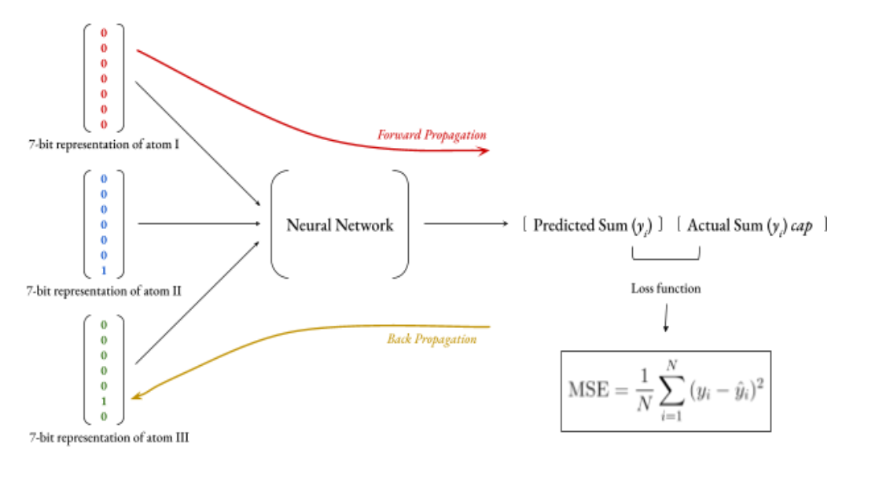

Slide 2
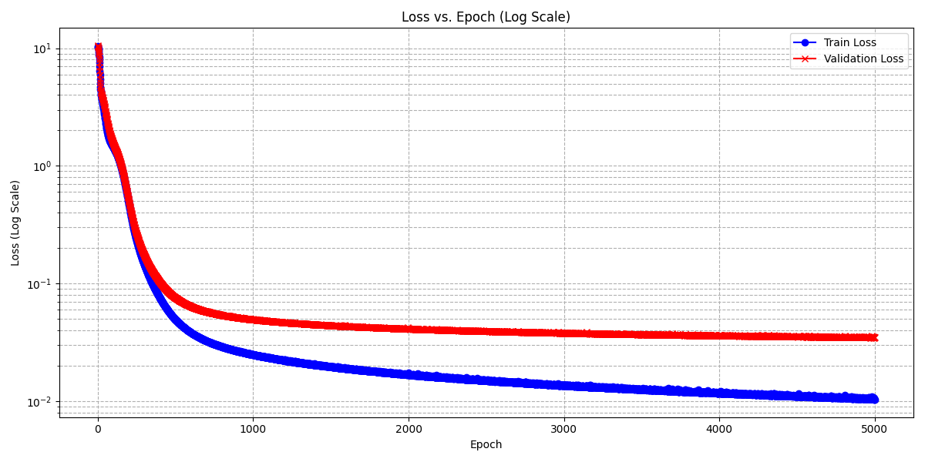
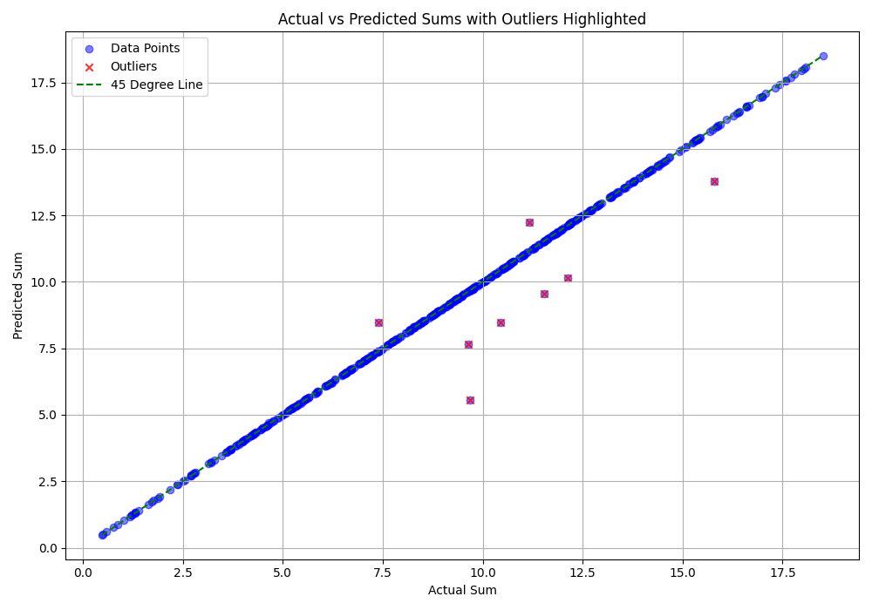
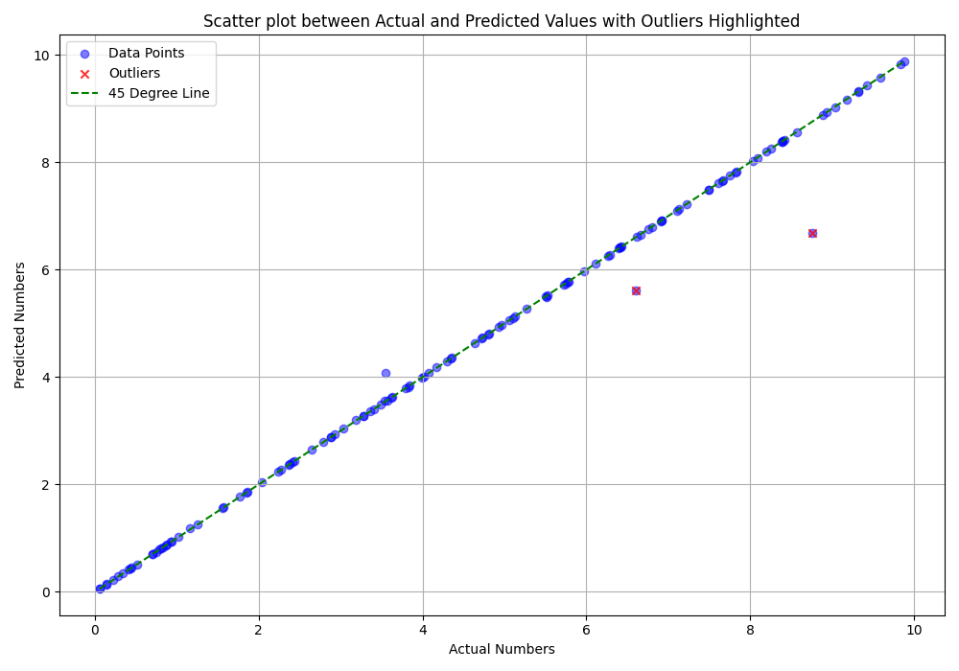
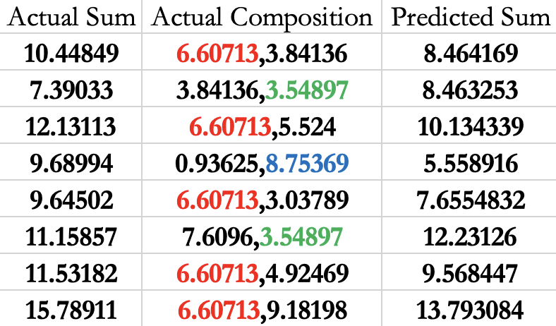
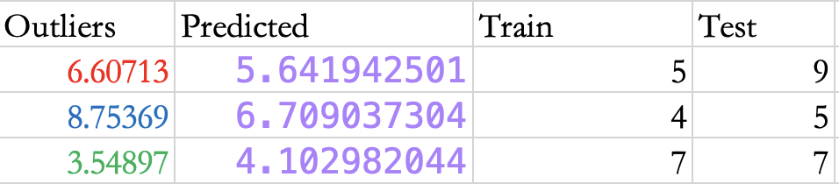

Slide 3
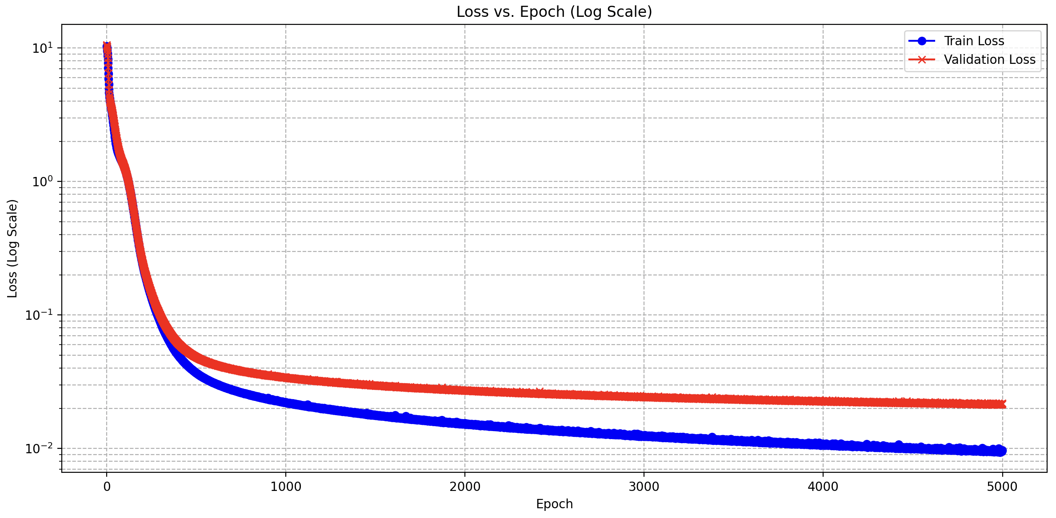
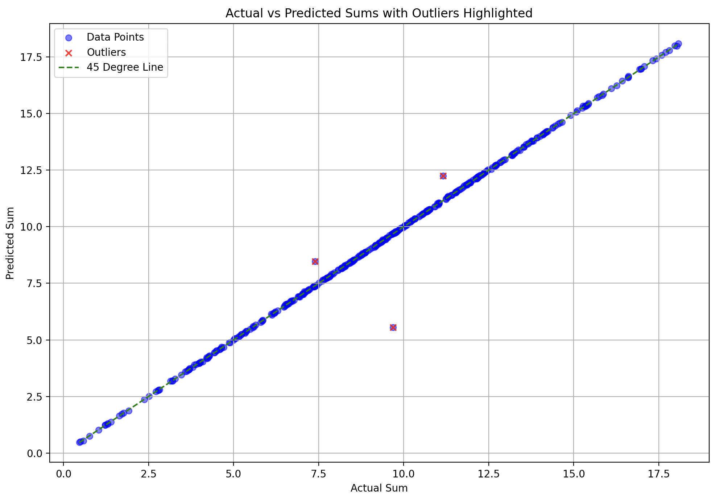
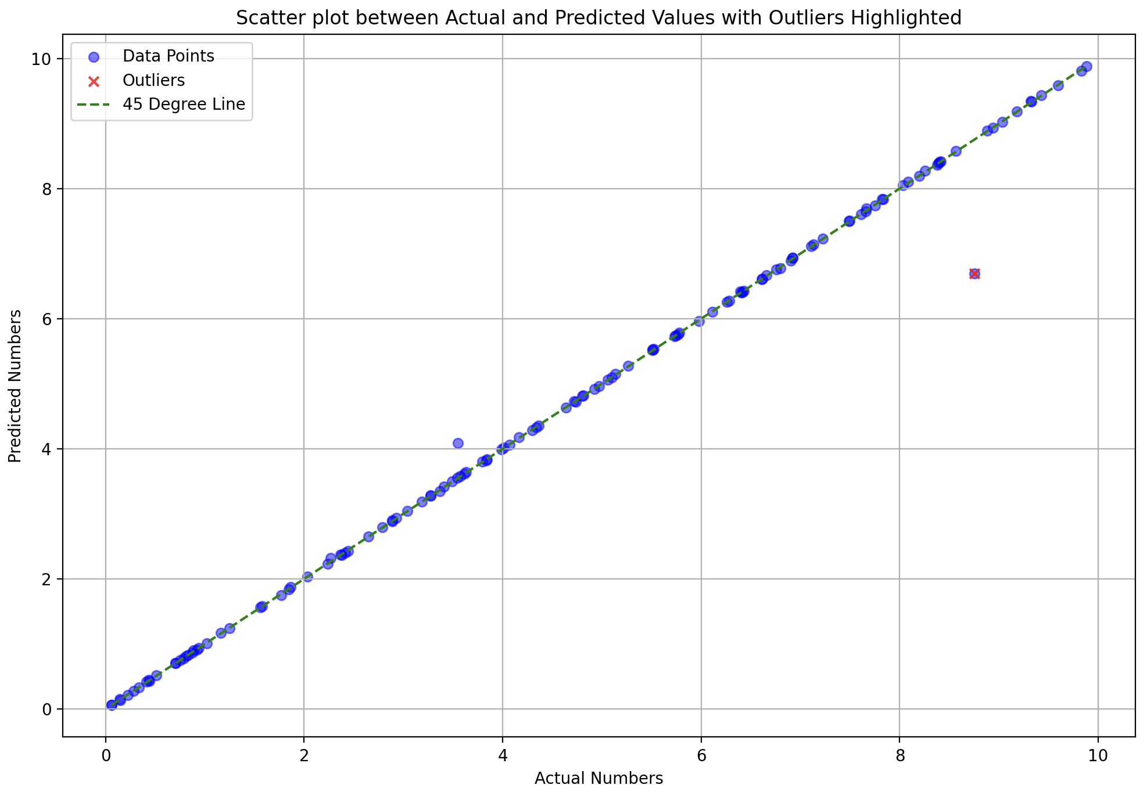
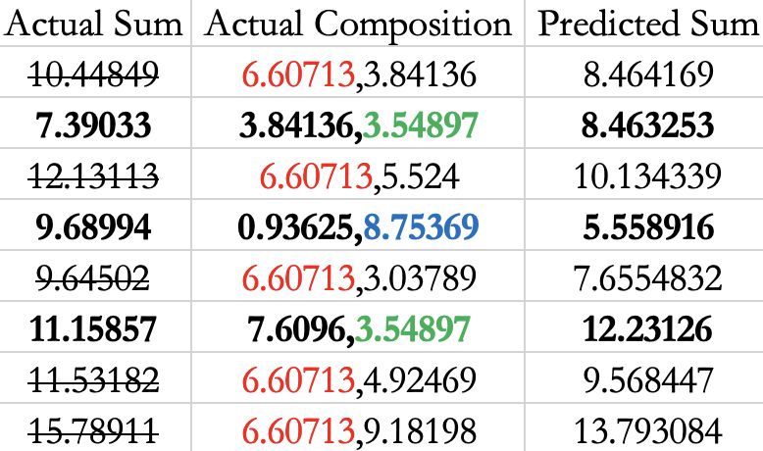
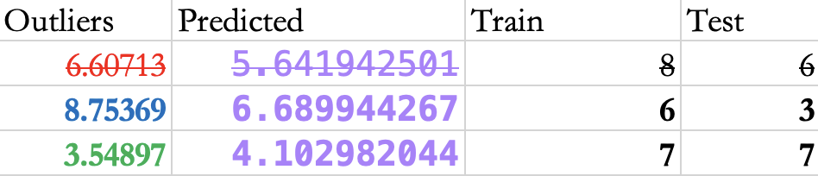

Slide 4
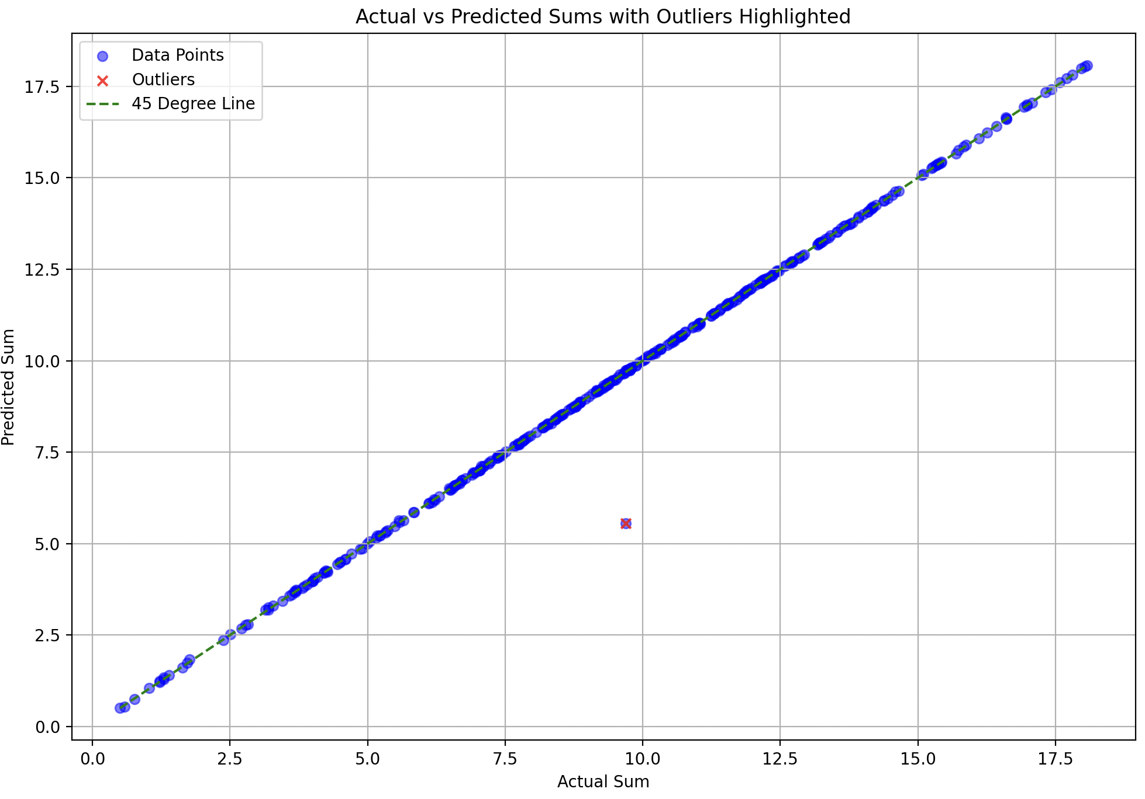
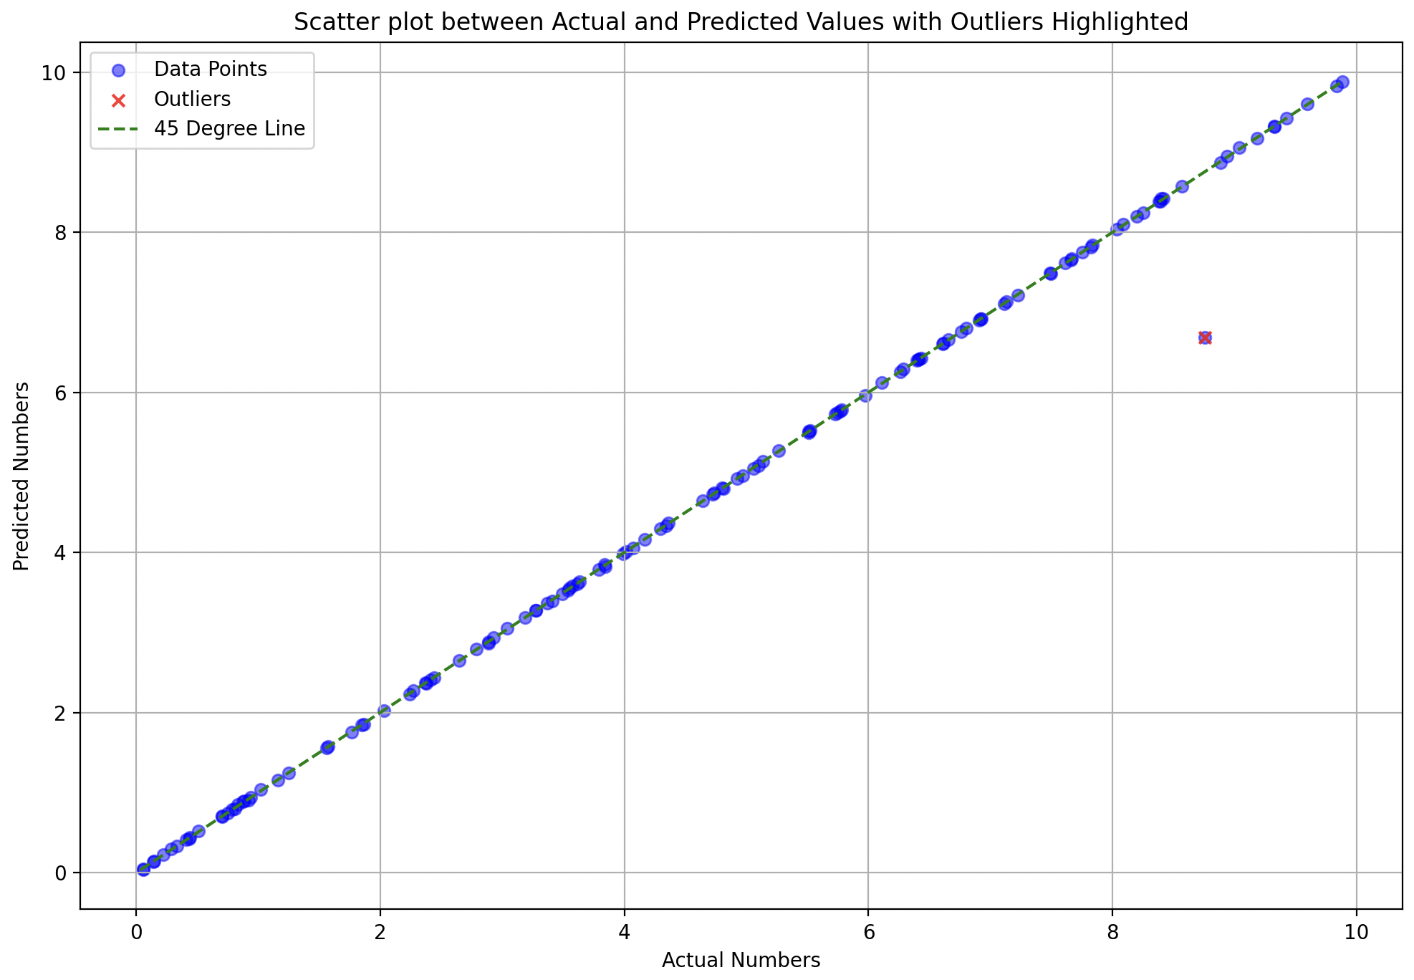
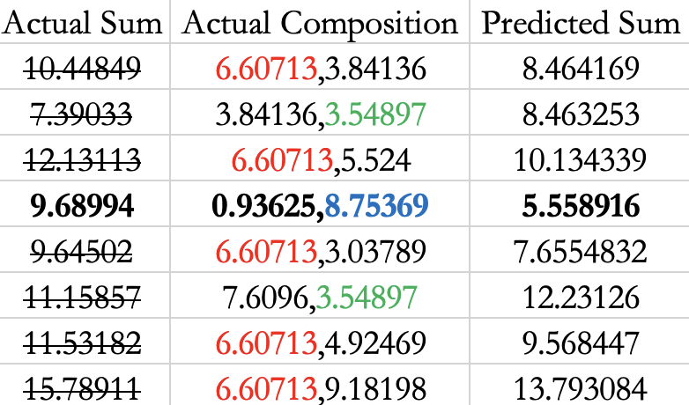
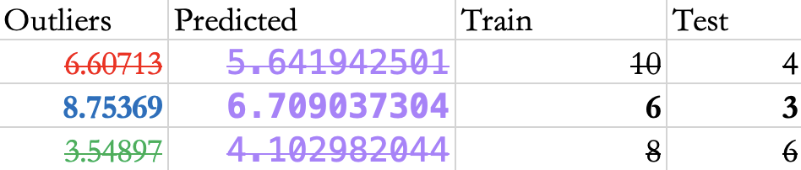

Slide 5
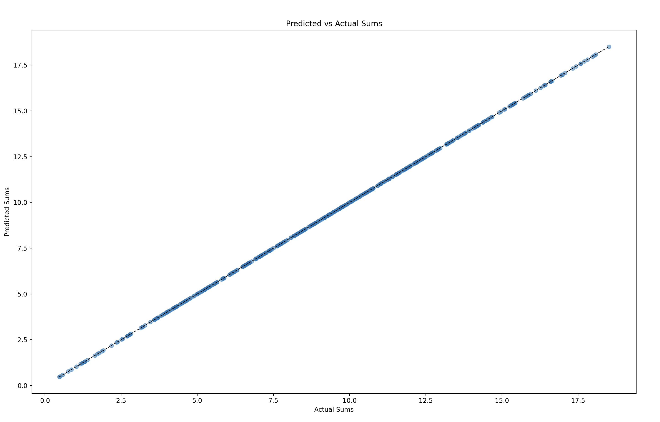
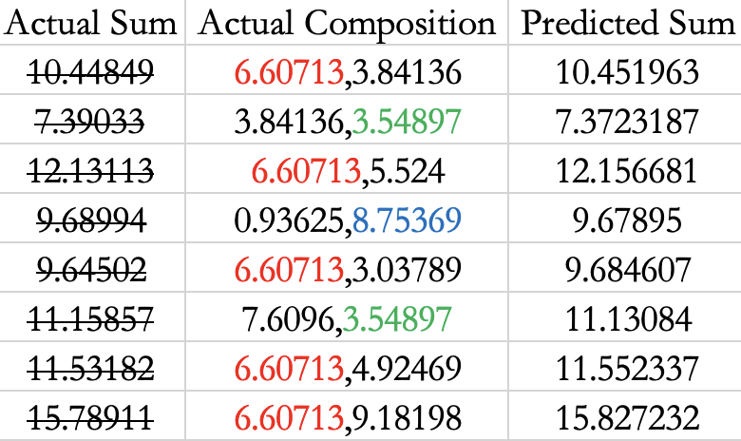
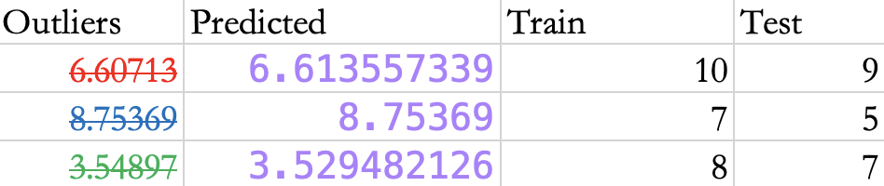
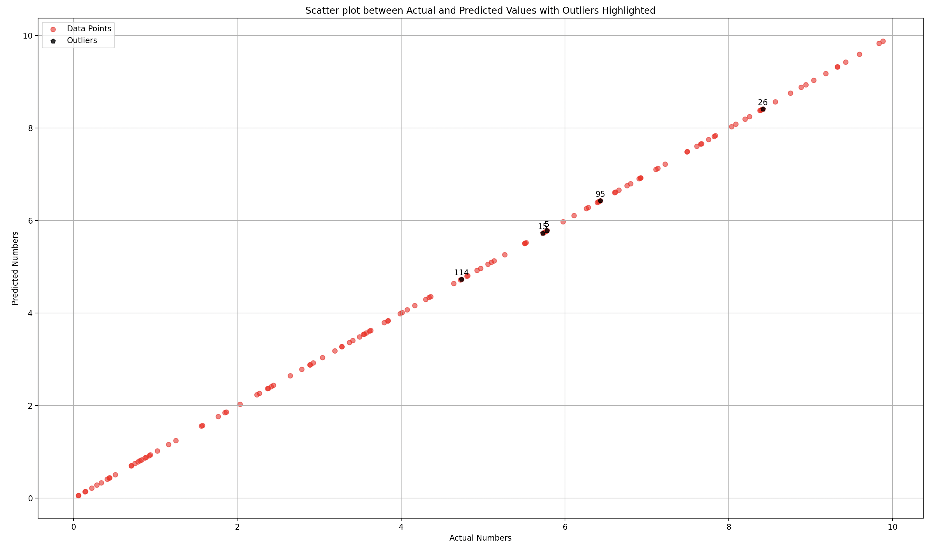
T
W
E
A
K
E
D
50-50

Slide 6
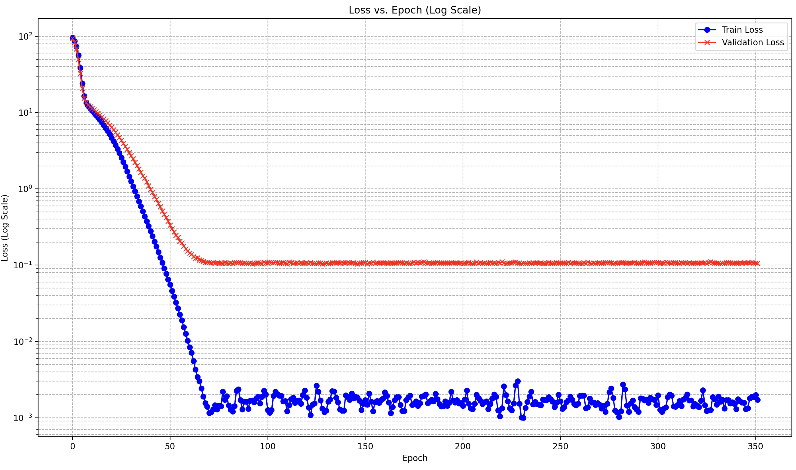
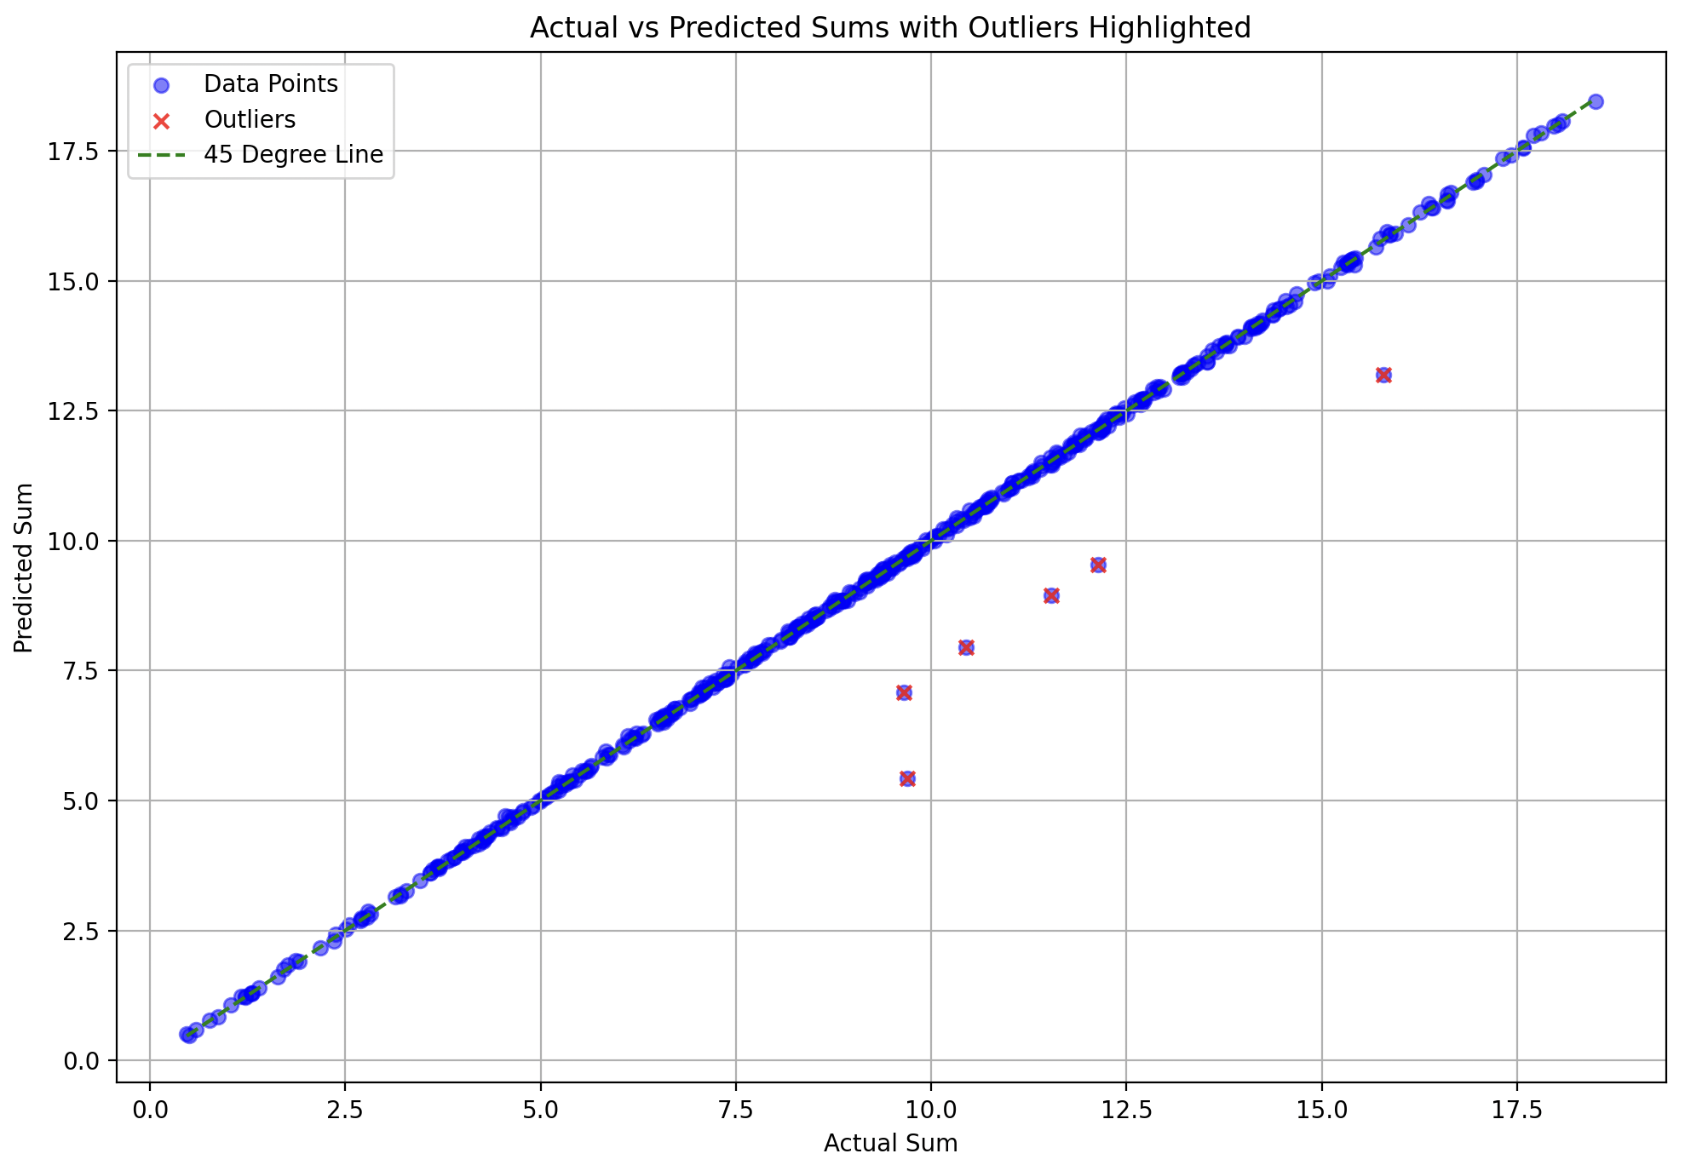
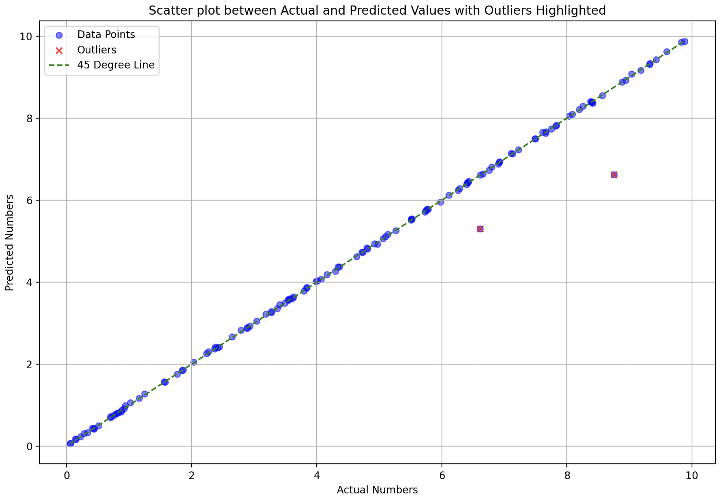
no decay, no dropout

Slide 7
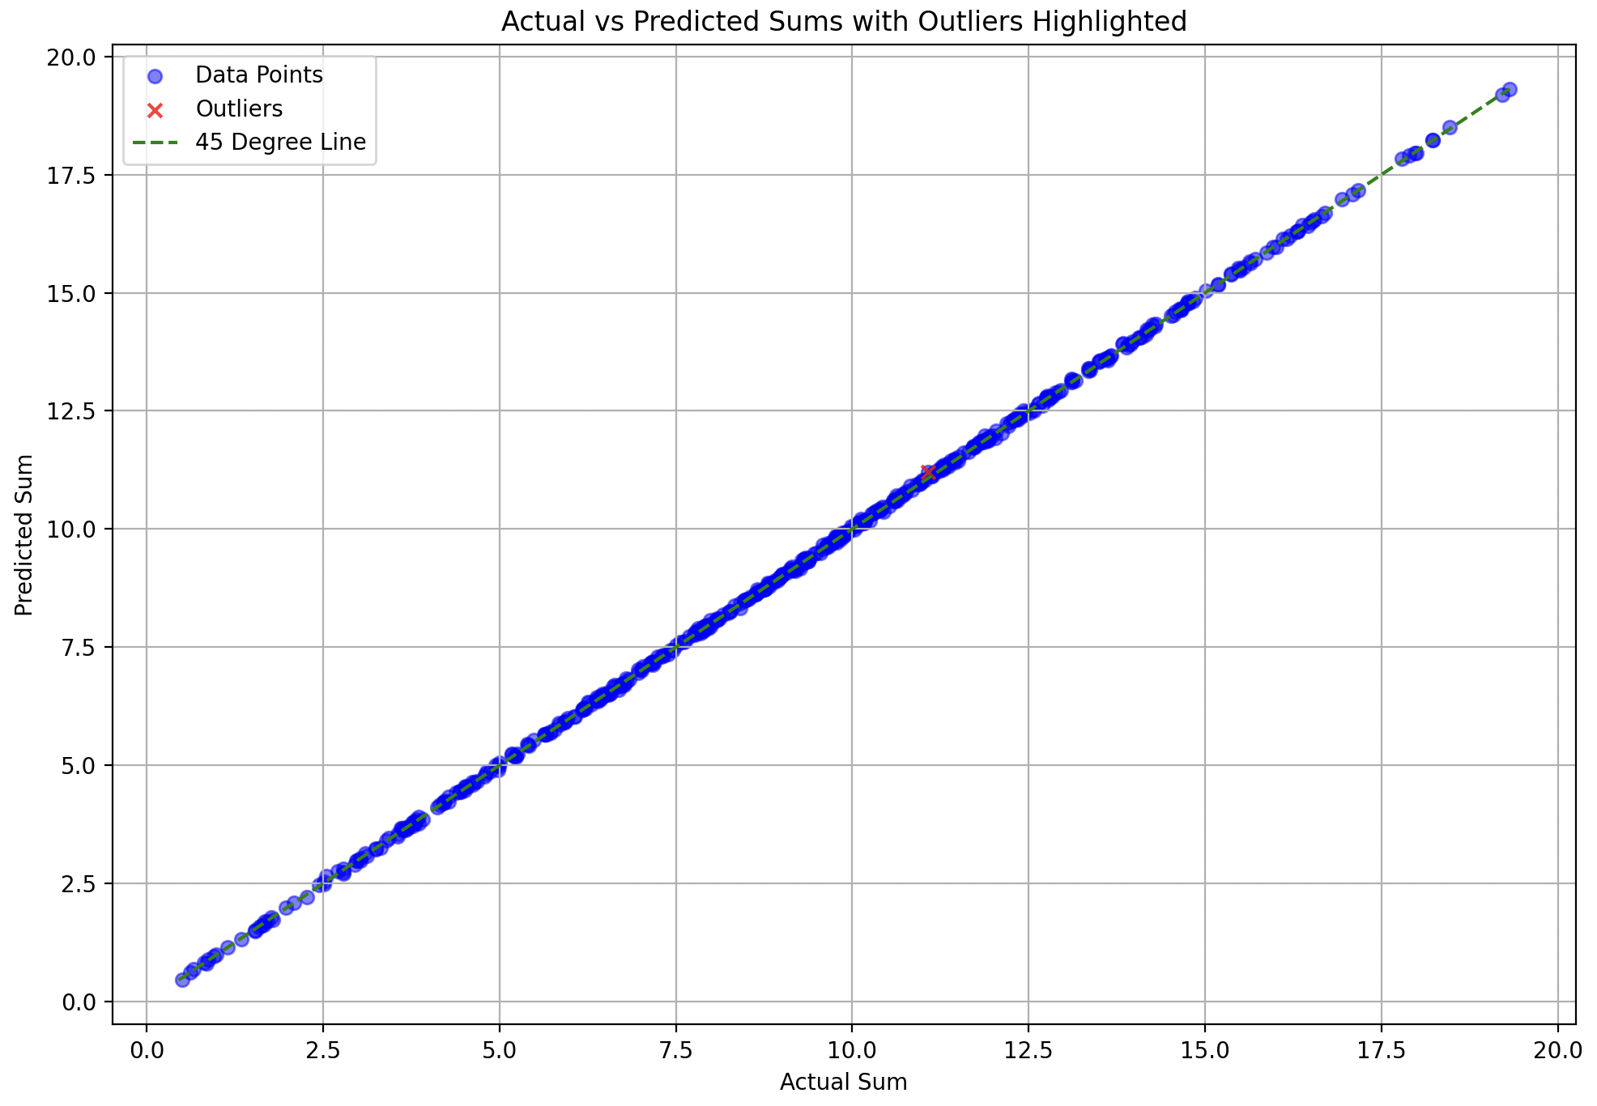
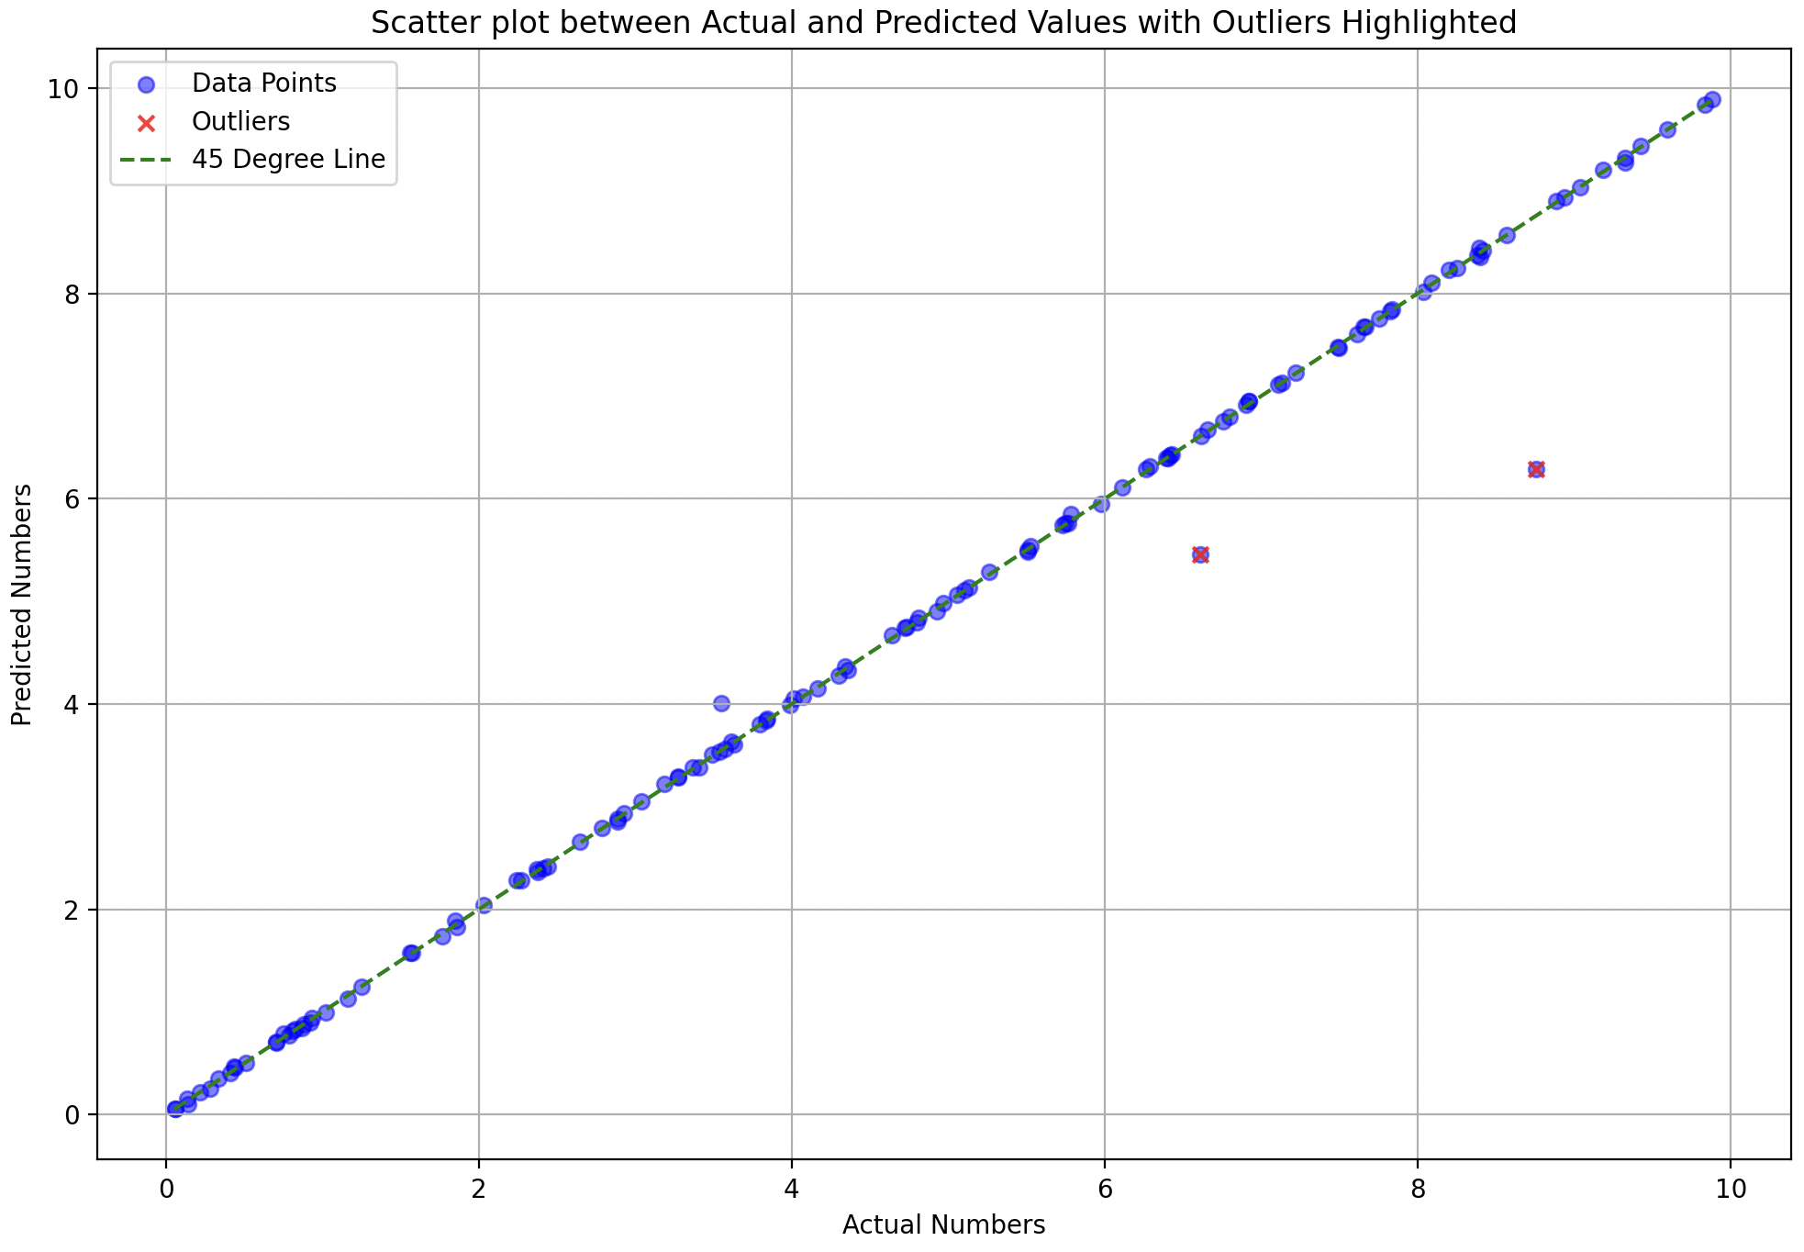
Performance on training data

Slide 8
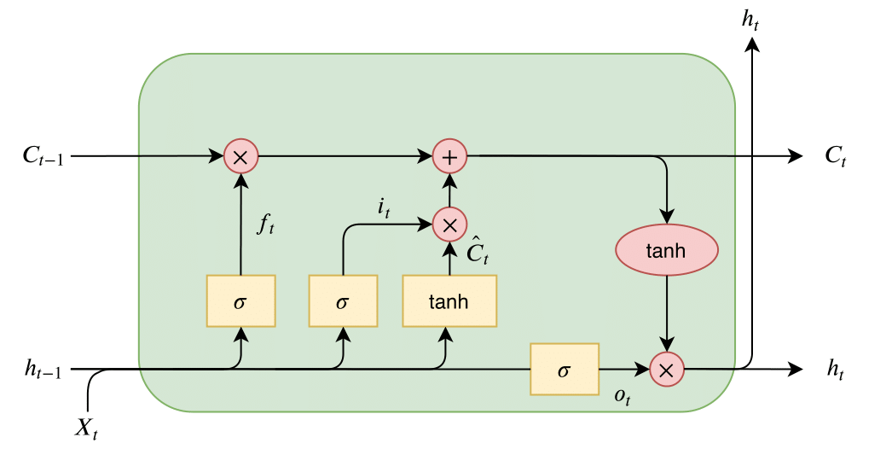

Slide 9
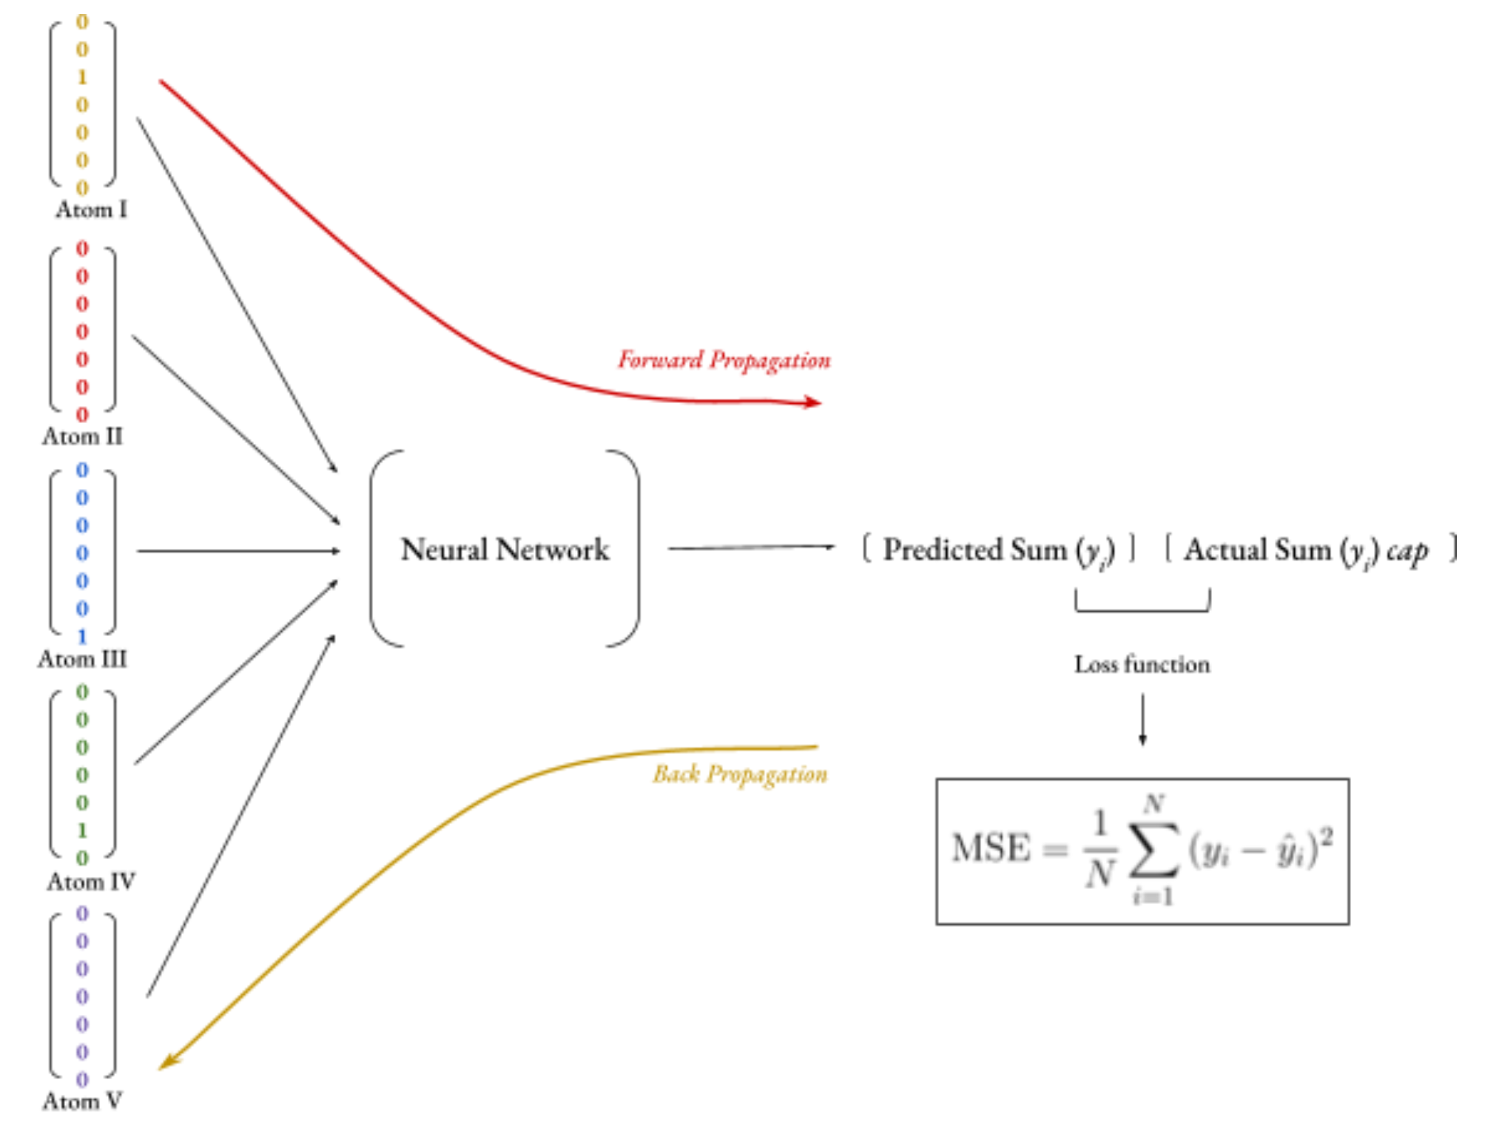
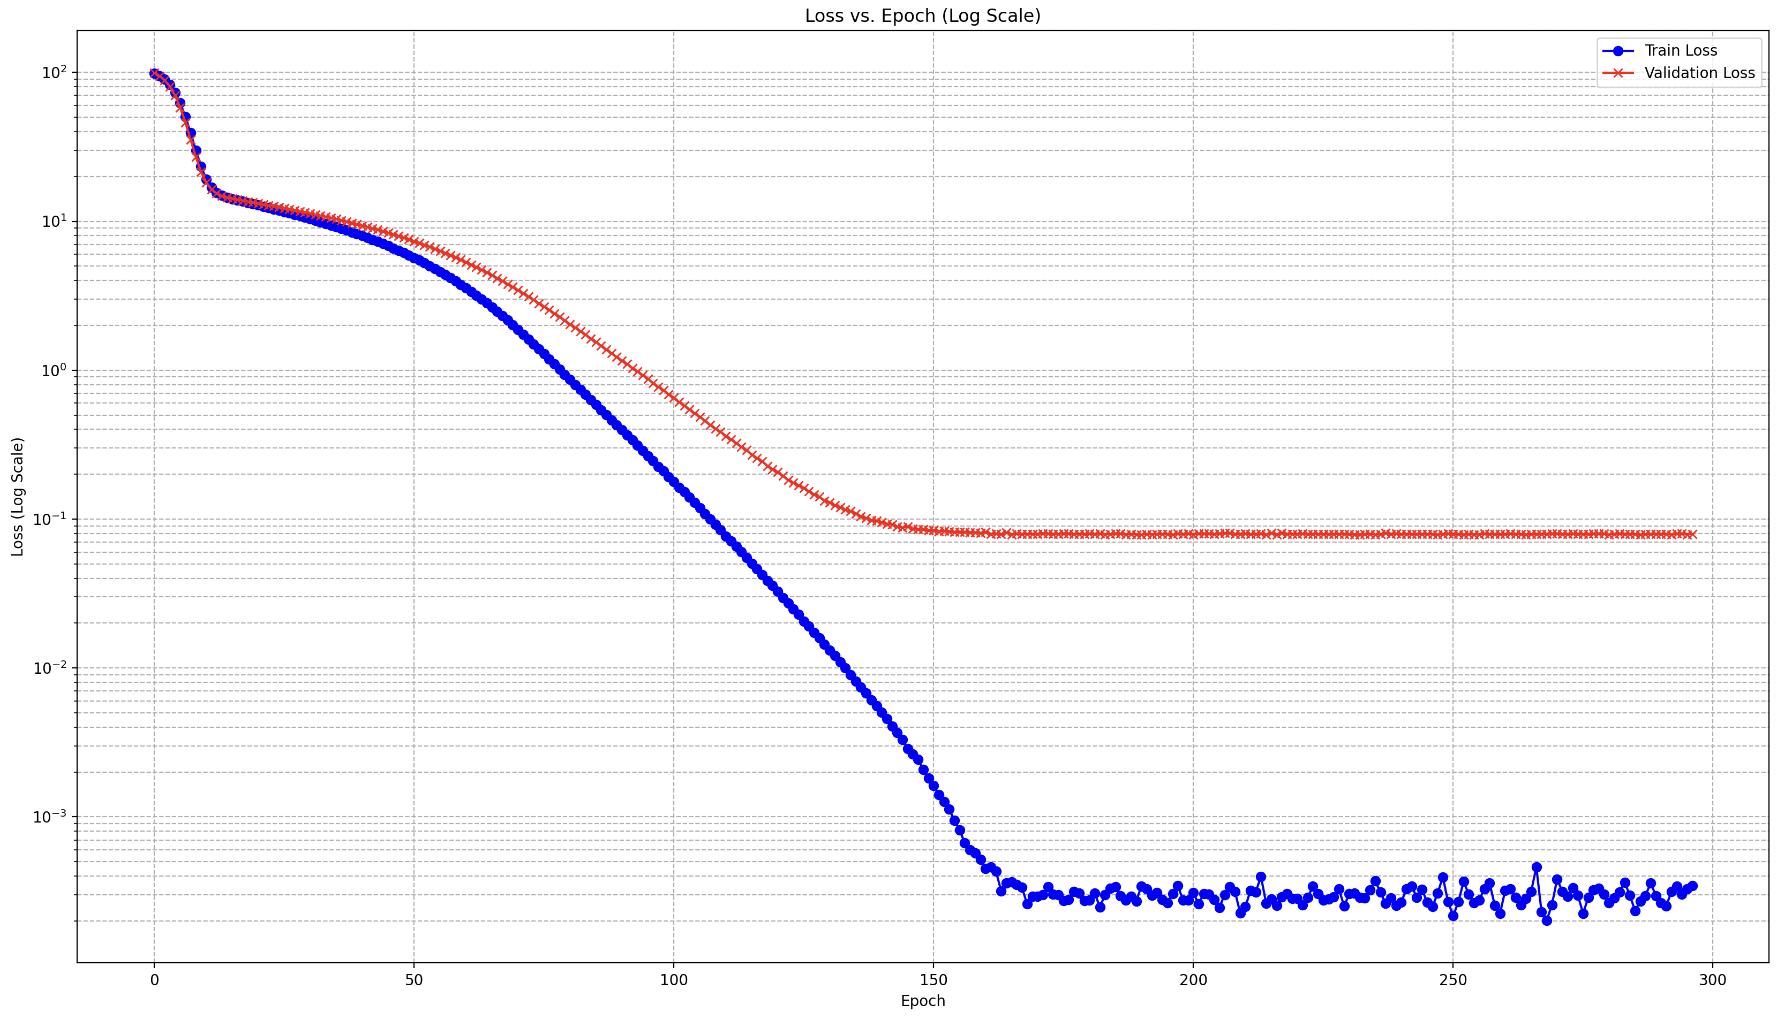
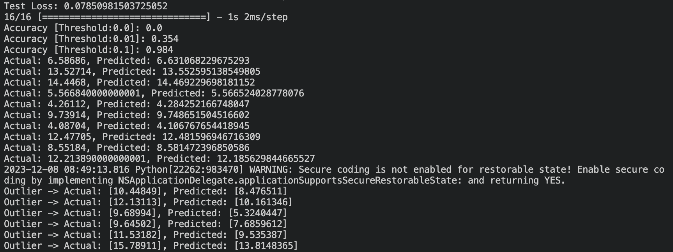
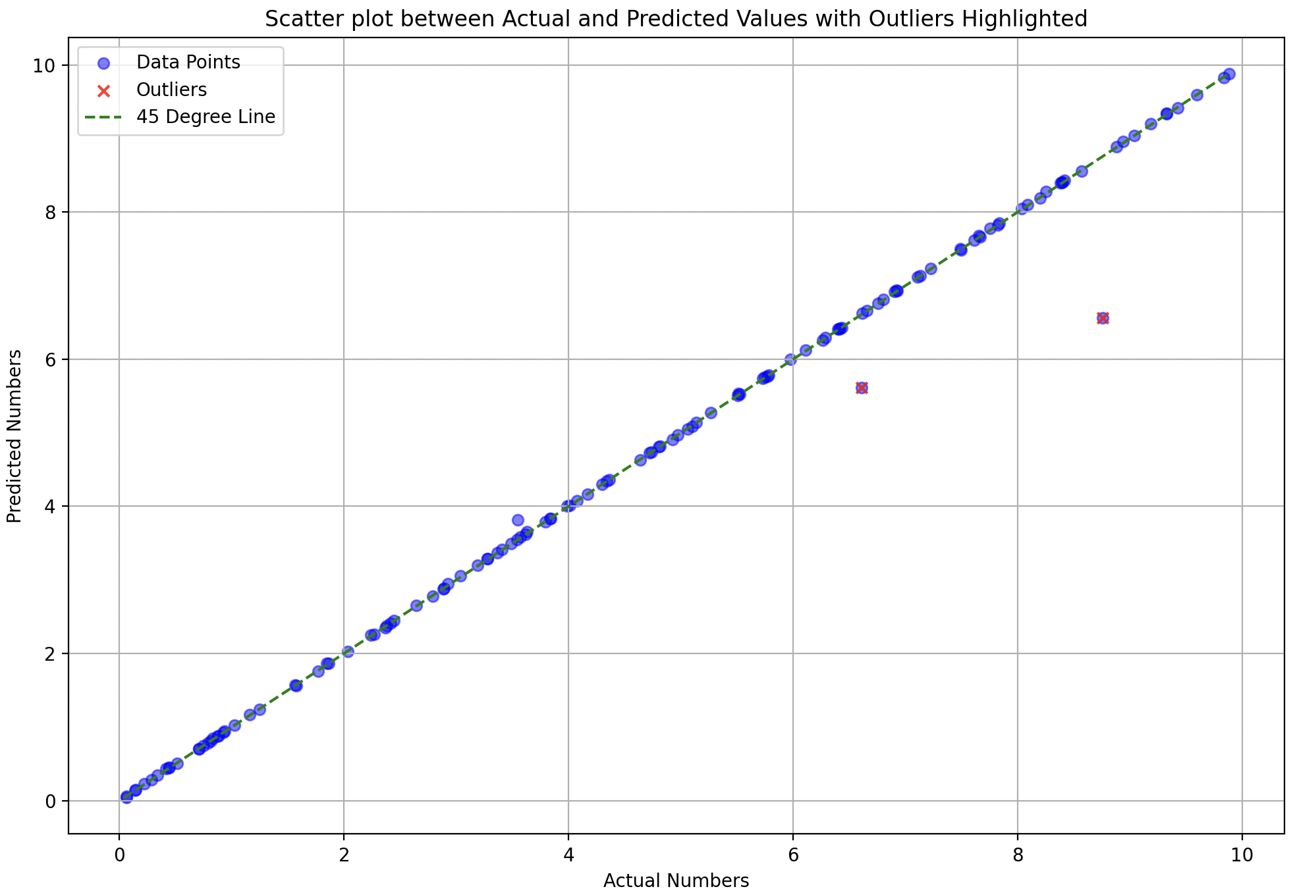
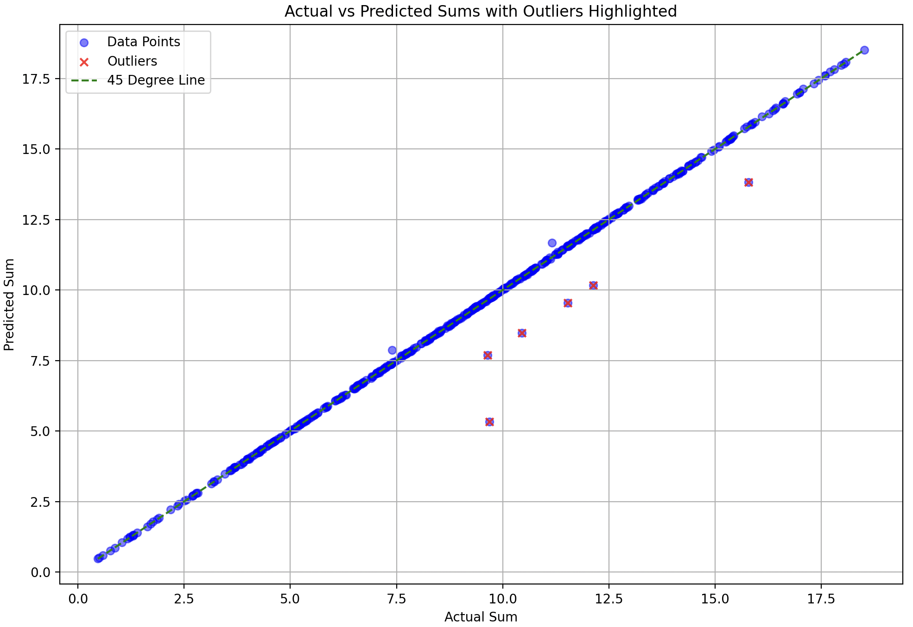
def shared_subnetwork(input_tensor): print(input_tensor.shape) x = LSTM(512, return_sequences=True)(input_tensor) ## h1 = LSTM(128, return_sequences=False)(x) h2 = Dense(64, activation='linear')(x) return h2
learning_rate = 0.00001
optimizer = Adam(learning_rate=learning_rate)
model.compile(optimizer=optimizer, loss='mean_squared_error’)
batch_size = 1
epochs = 800
Split: 50-50
You’re sending all numbers (128) for the left plot but what if not all 128 numbers come in training or some issue that is close to this)

Slide 10
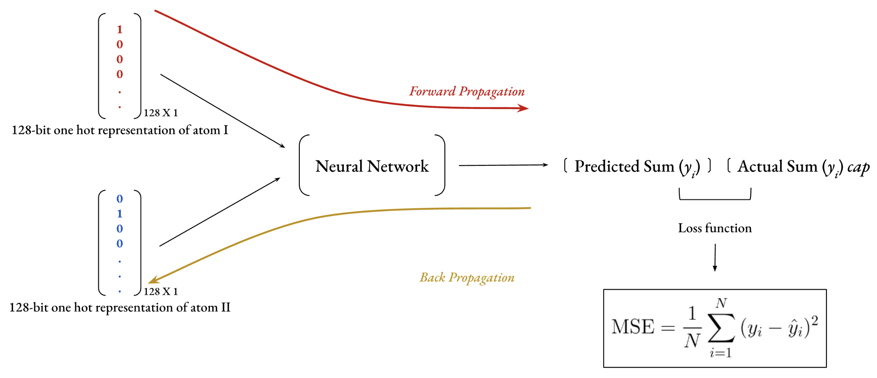

Slide 11
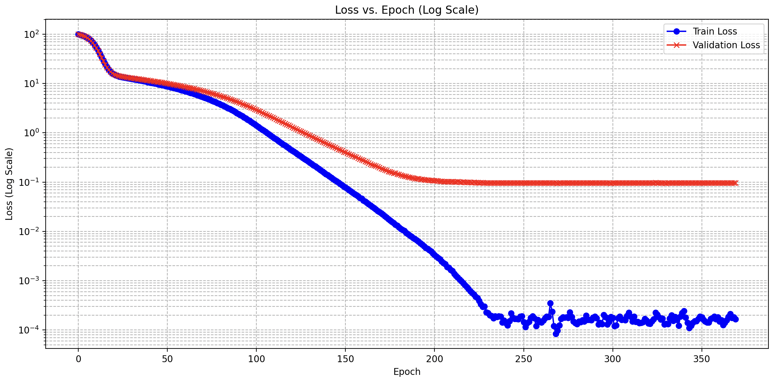
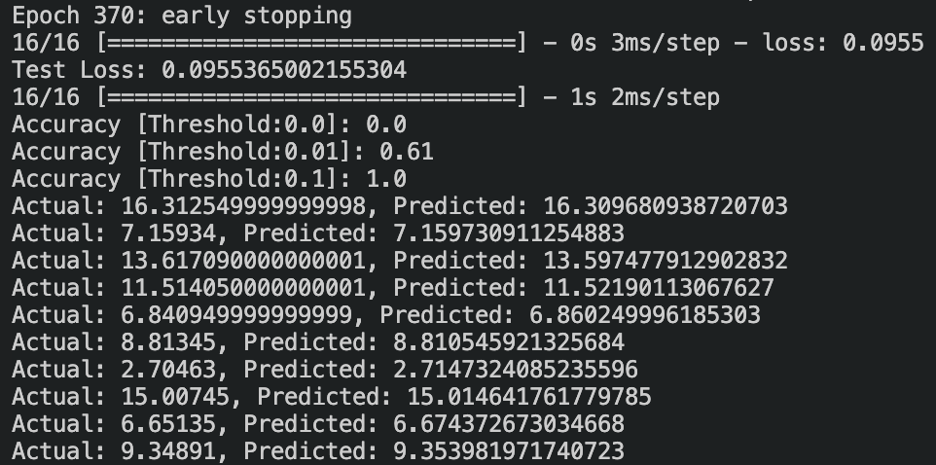
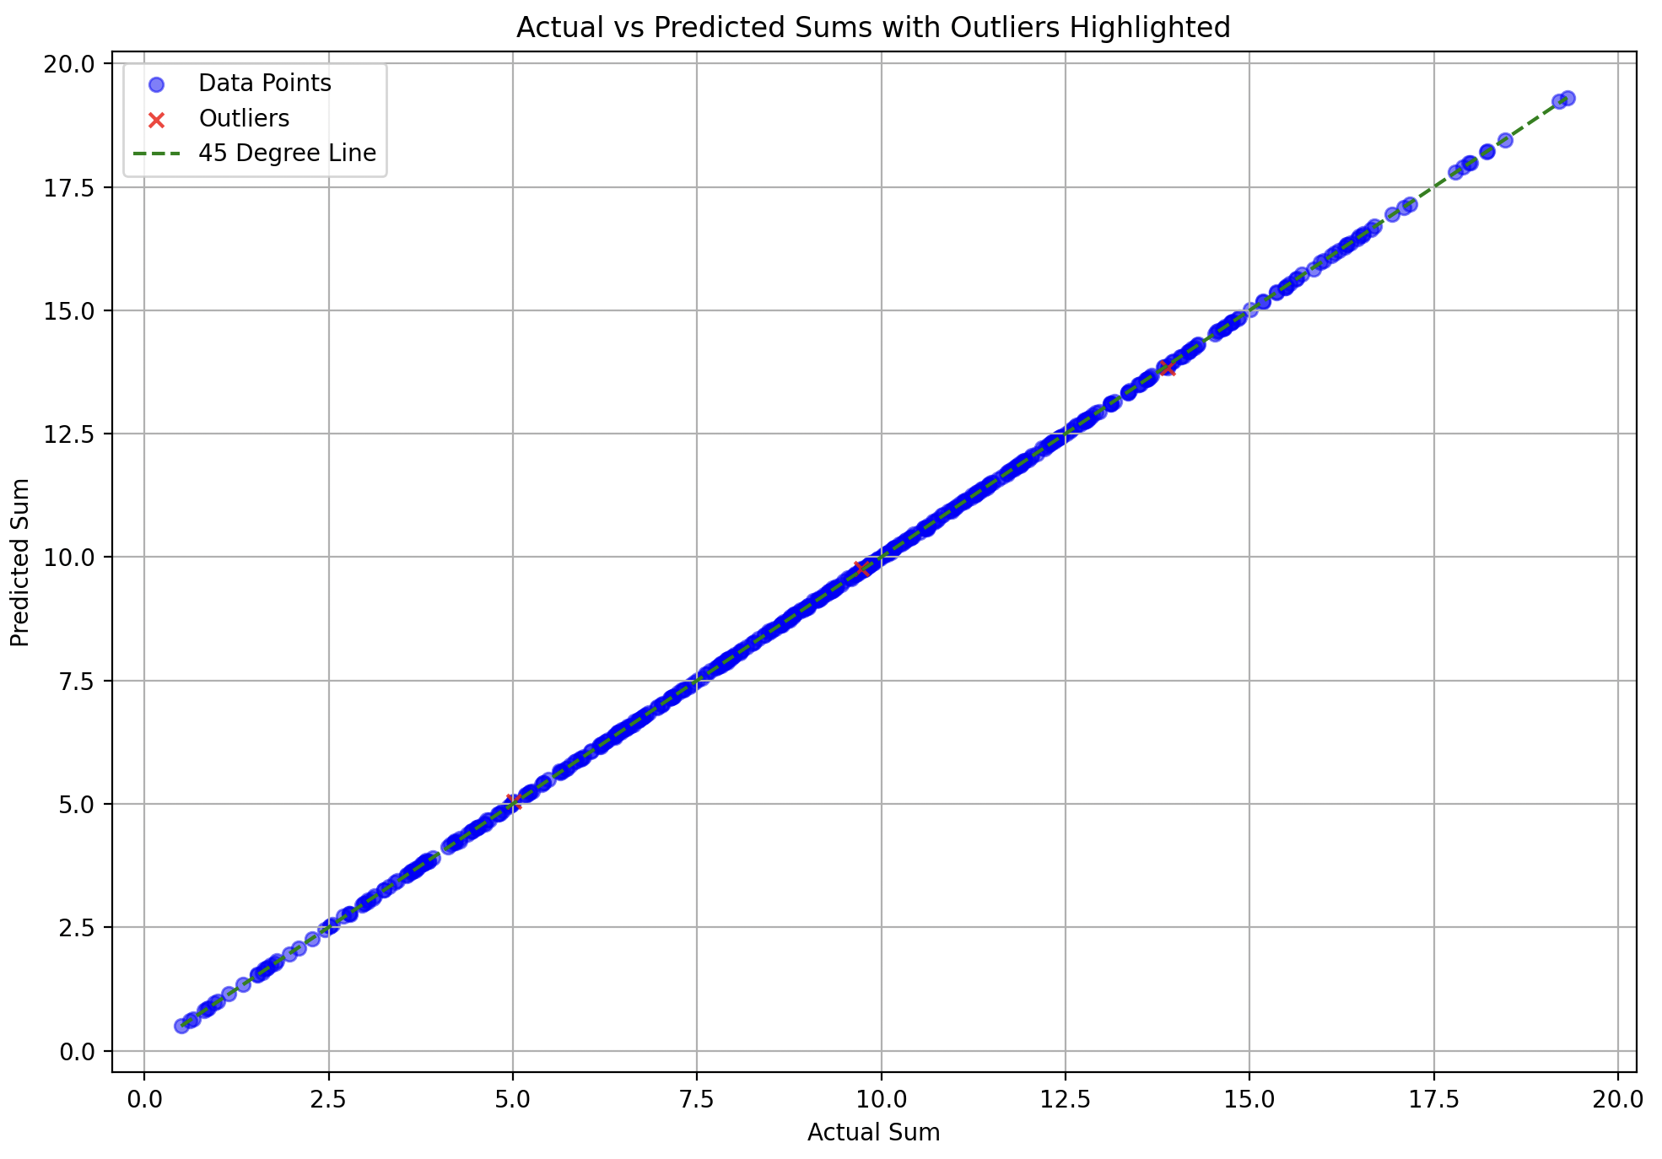
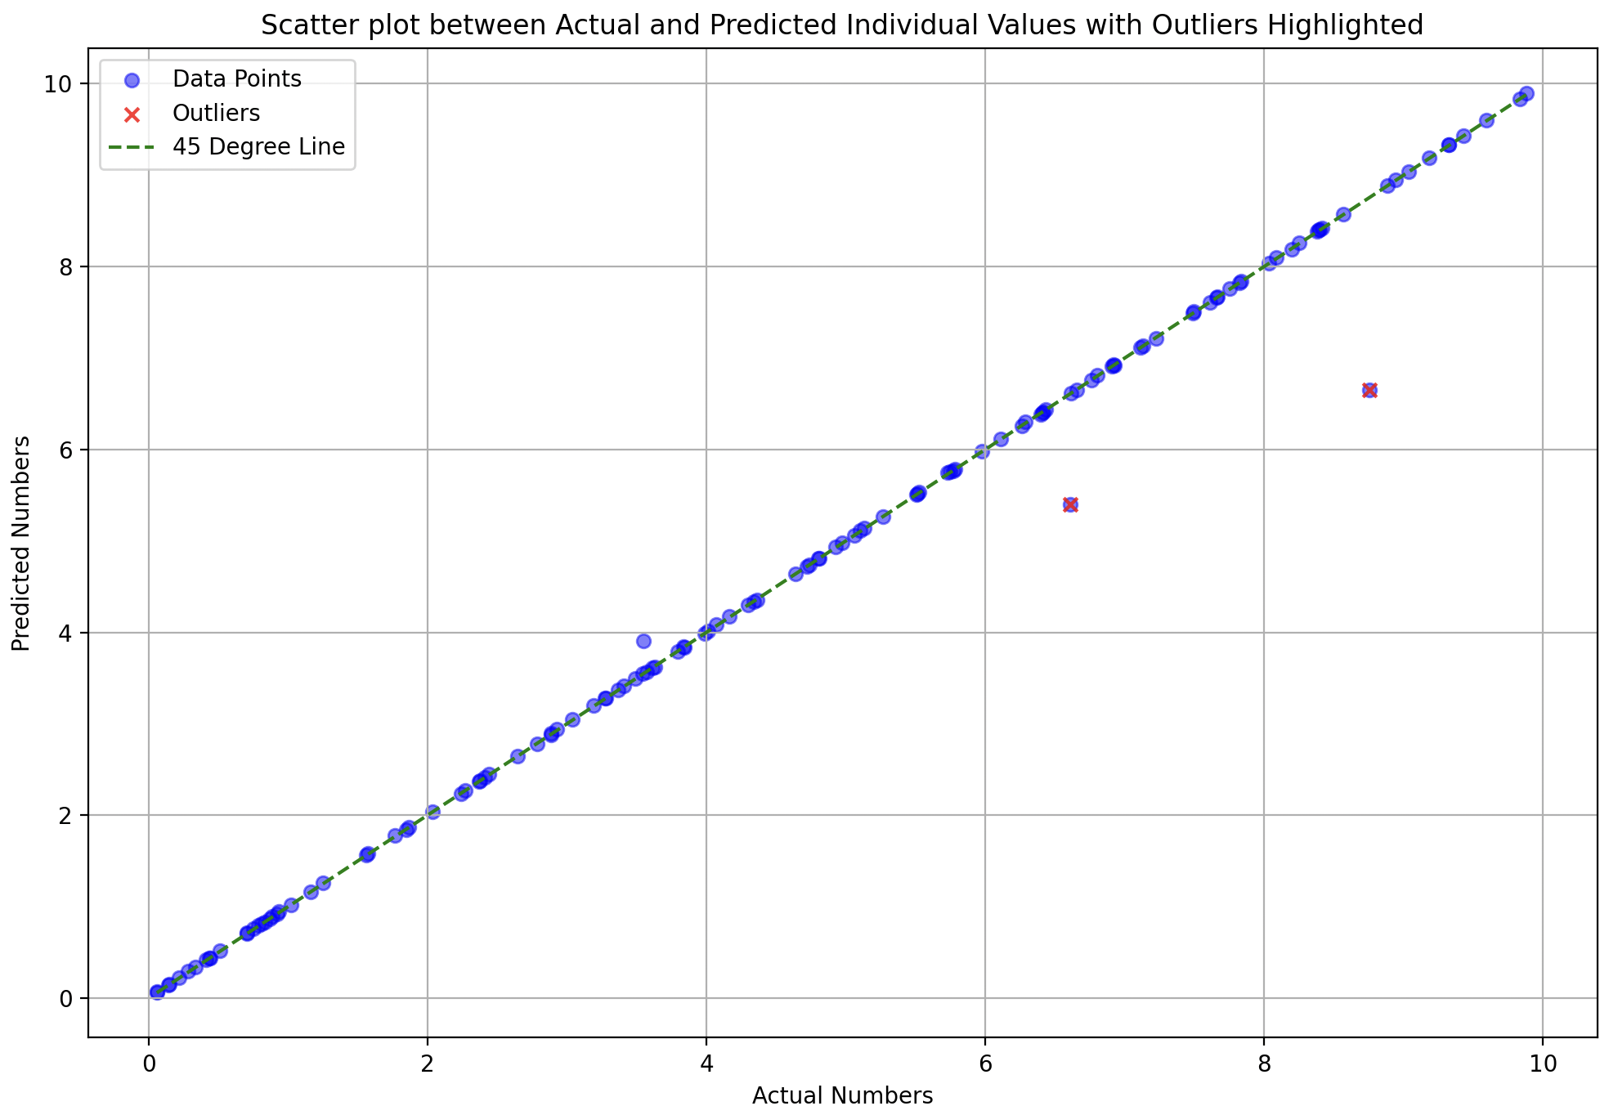
learning_rate = 0.00001 model.compile(optimizer=‘adam’, loss='mean_squared_error’) batch_size = 2 epochs = 800 early_stopping = EarlyStopping(monitor='val_loss', patience=100, verbose=1, restore_best_weights=True) ~no learning rate scheduler
Performance on training data

Slide 12
What’s wrong? Why the outliers?
Training is perfect
Not enough data for the model to learn (train on) all the pairs of numbers and their sums (present in testing but not in testing)
Model learns how to behave with training data, but not the new testing data (due to less data?)

Slide 13
Try [0-20] spread – does variety help? (-)
Contextual based - environment of the number in the pair matters? (+)

Slide 14
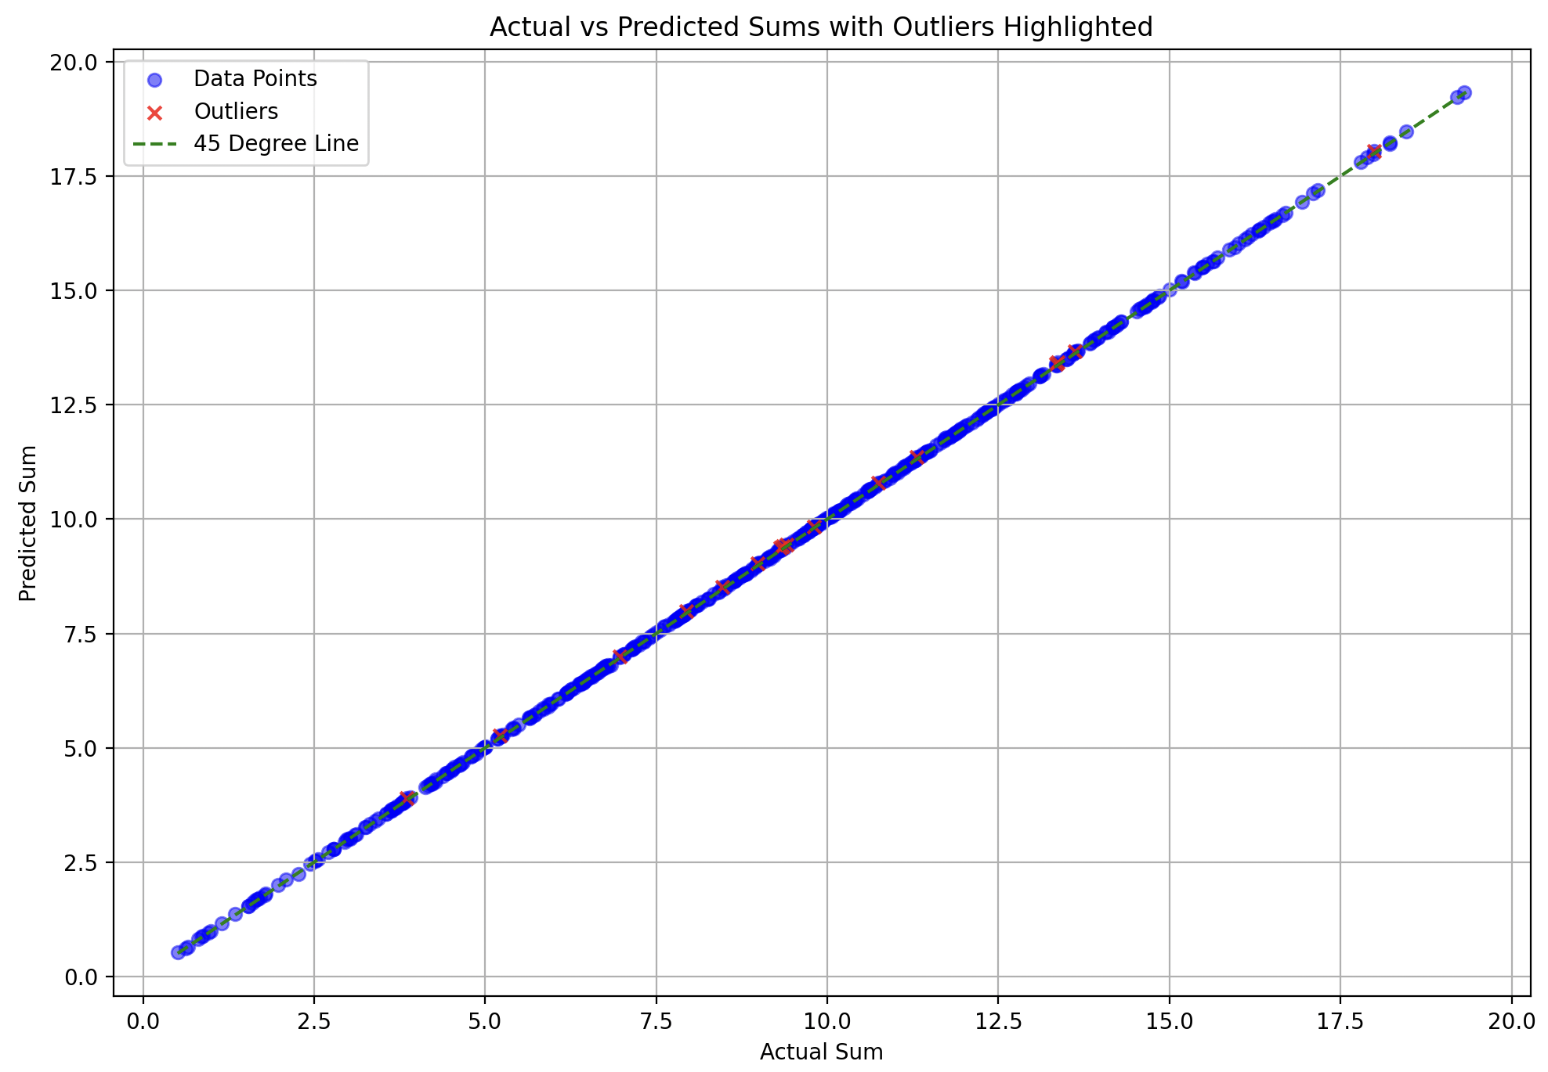
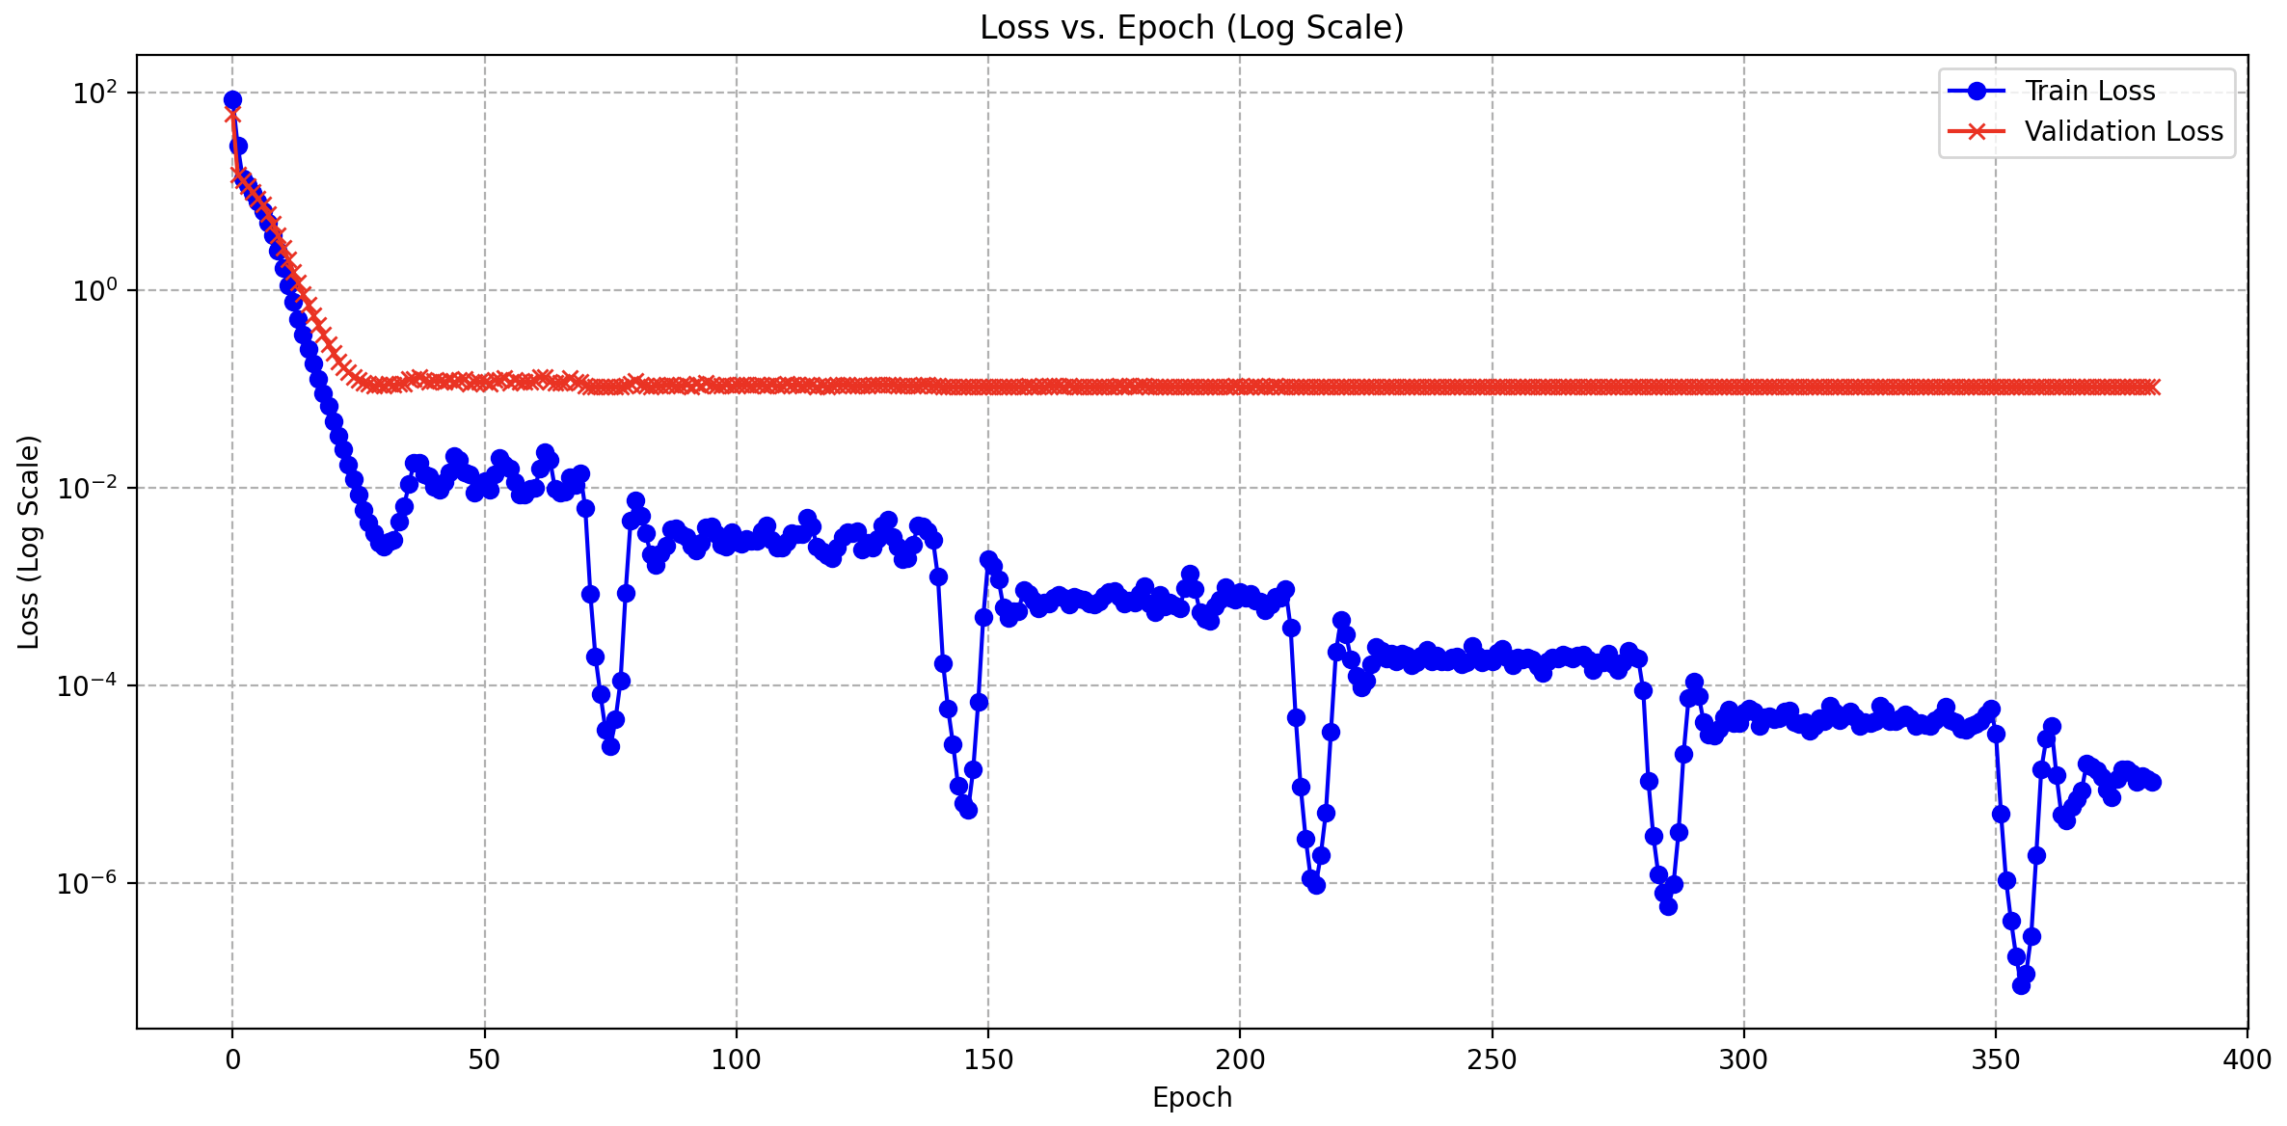
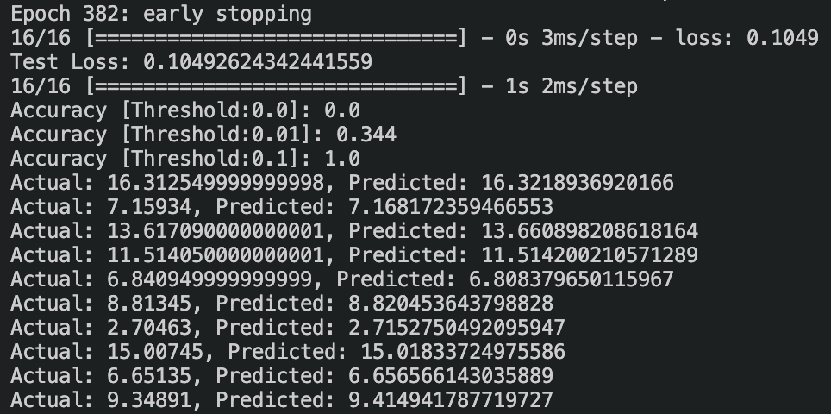
model.compile(optimizer=‘Adam’, loss='mean_squared_error’) batch_size = 2 epochs = 490 early_stopping = EarlyStopping(monitor='val_loss', patience=150, verbose=1, restore_best_weights=True) ~ learning rate scheduler initial_lr = 0.0001 decay_factor = 0.5 step_size = 70

Slide 15
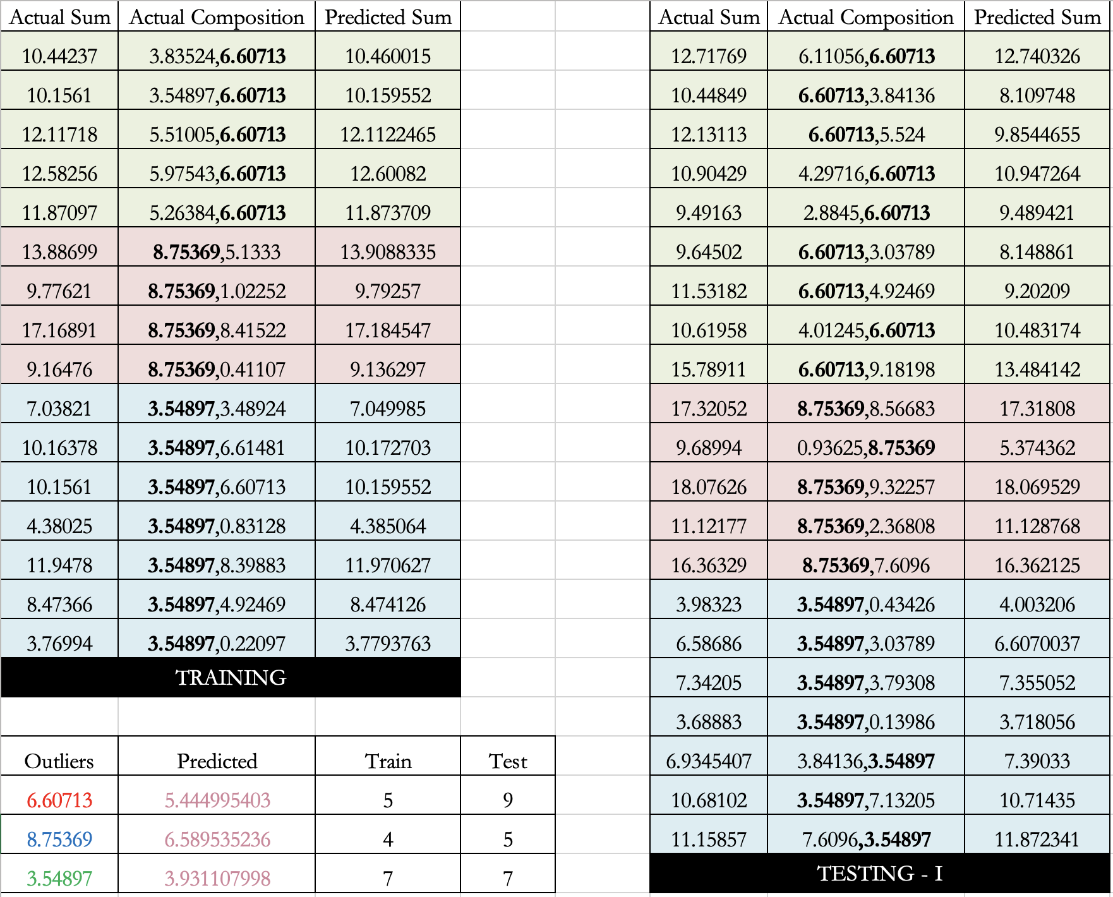
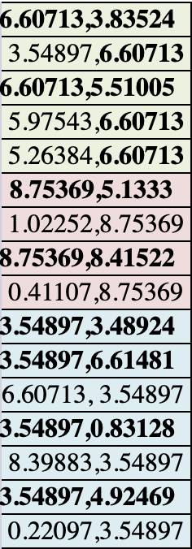

Slide 16
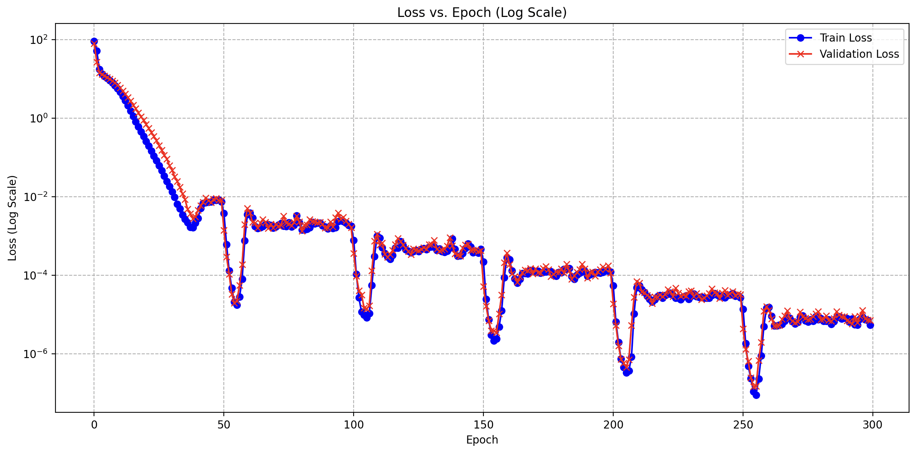
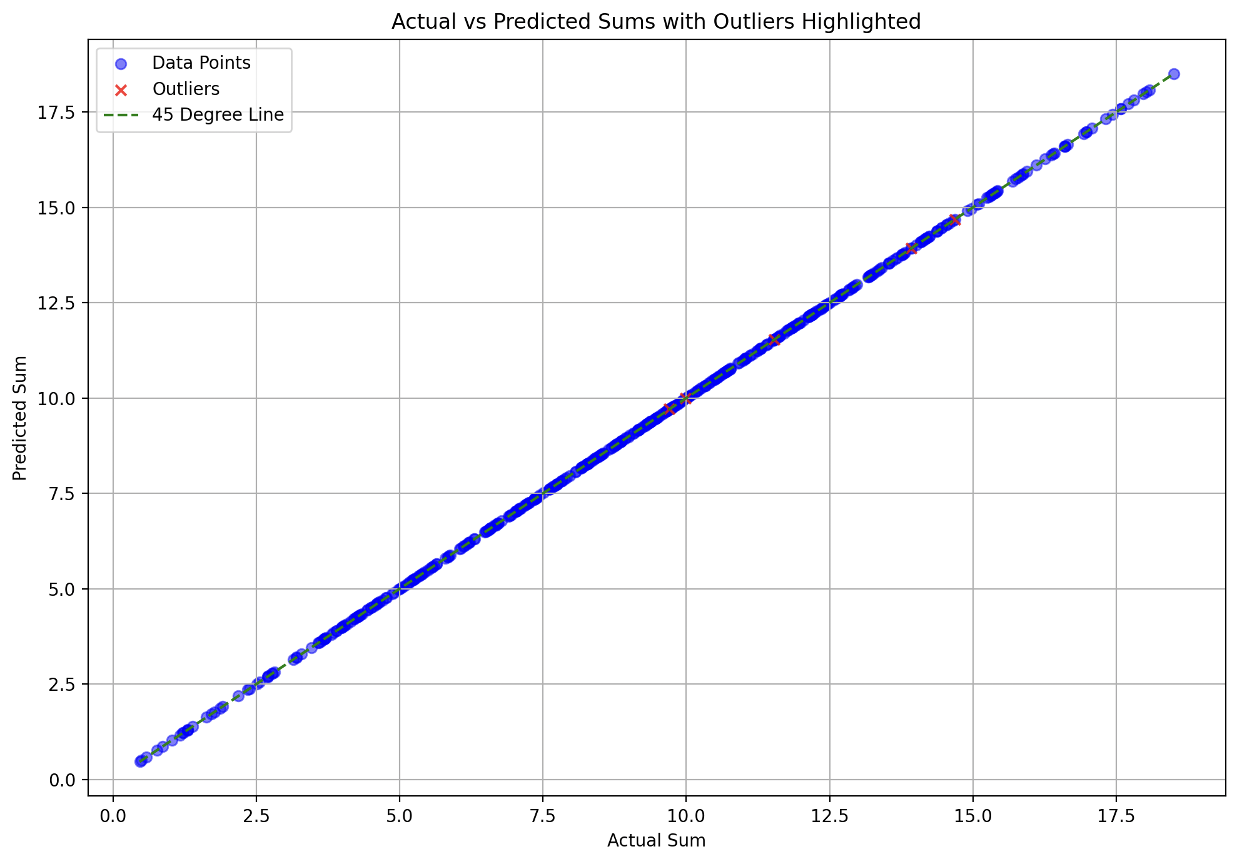
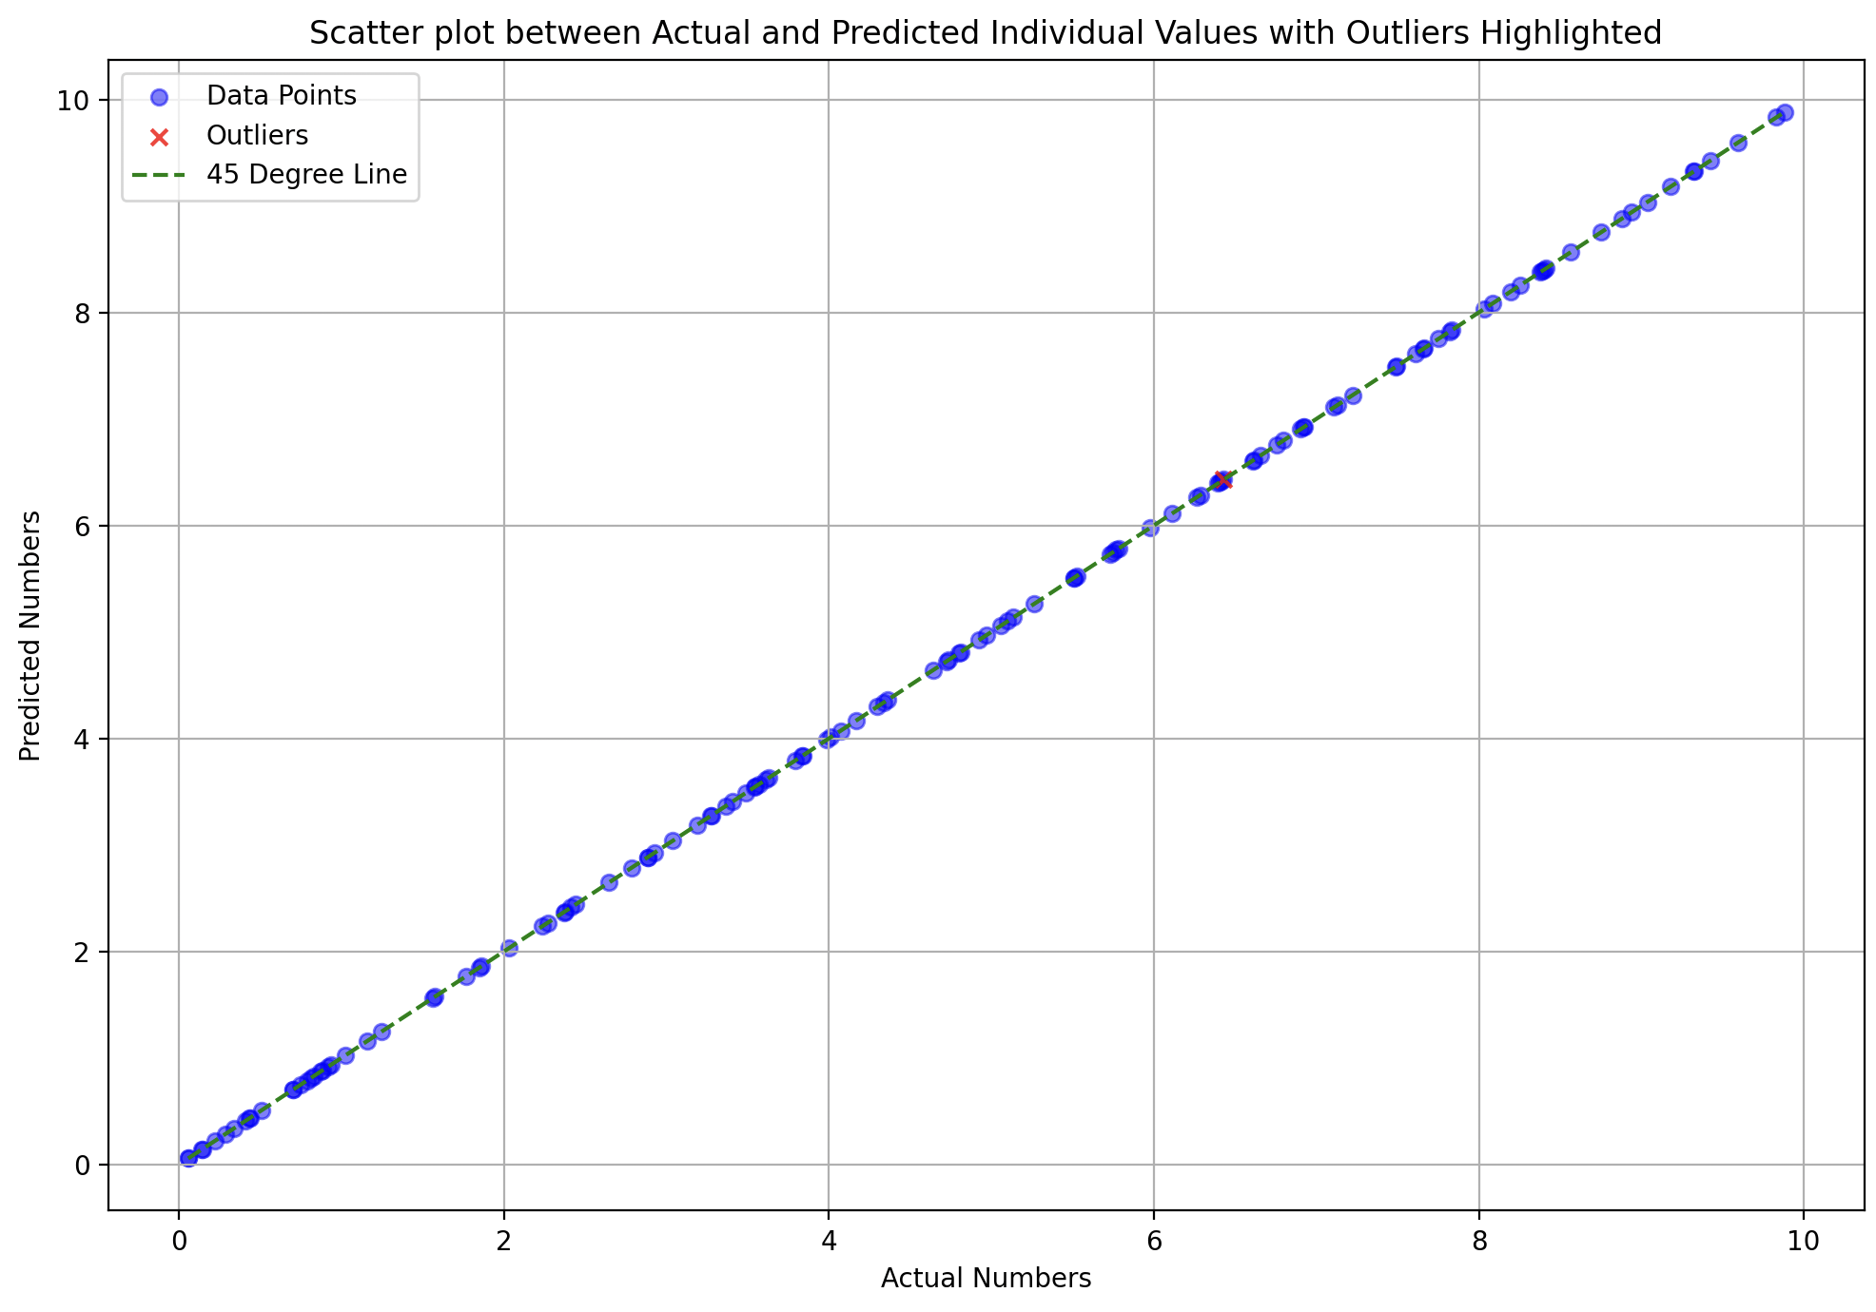
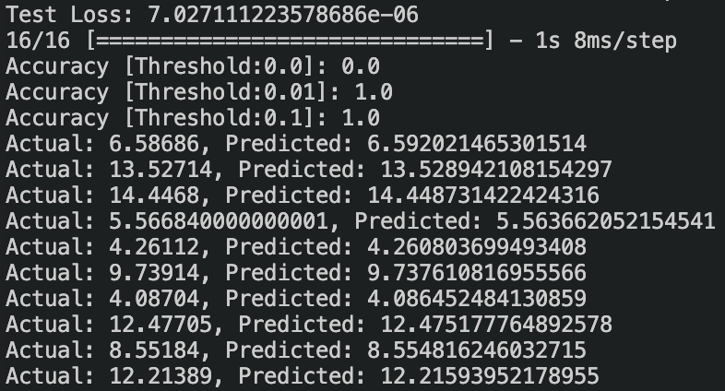

Slide 17
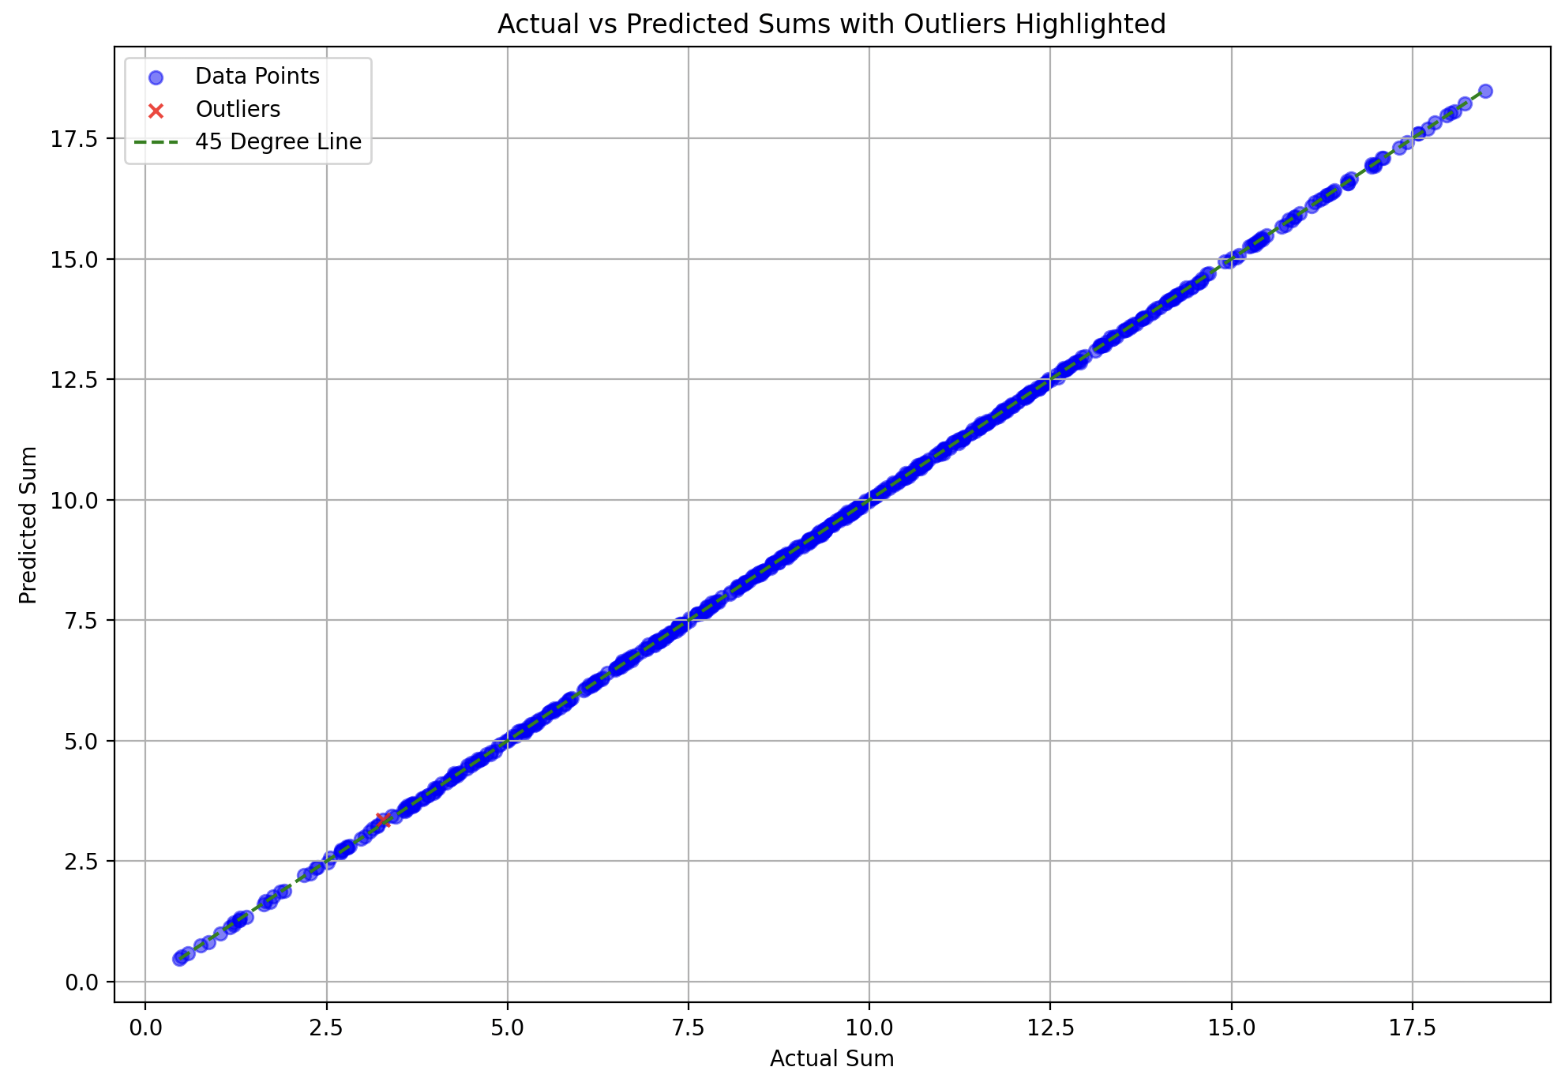
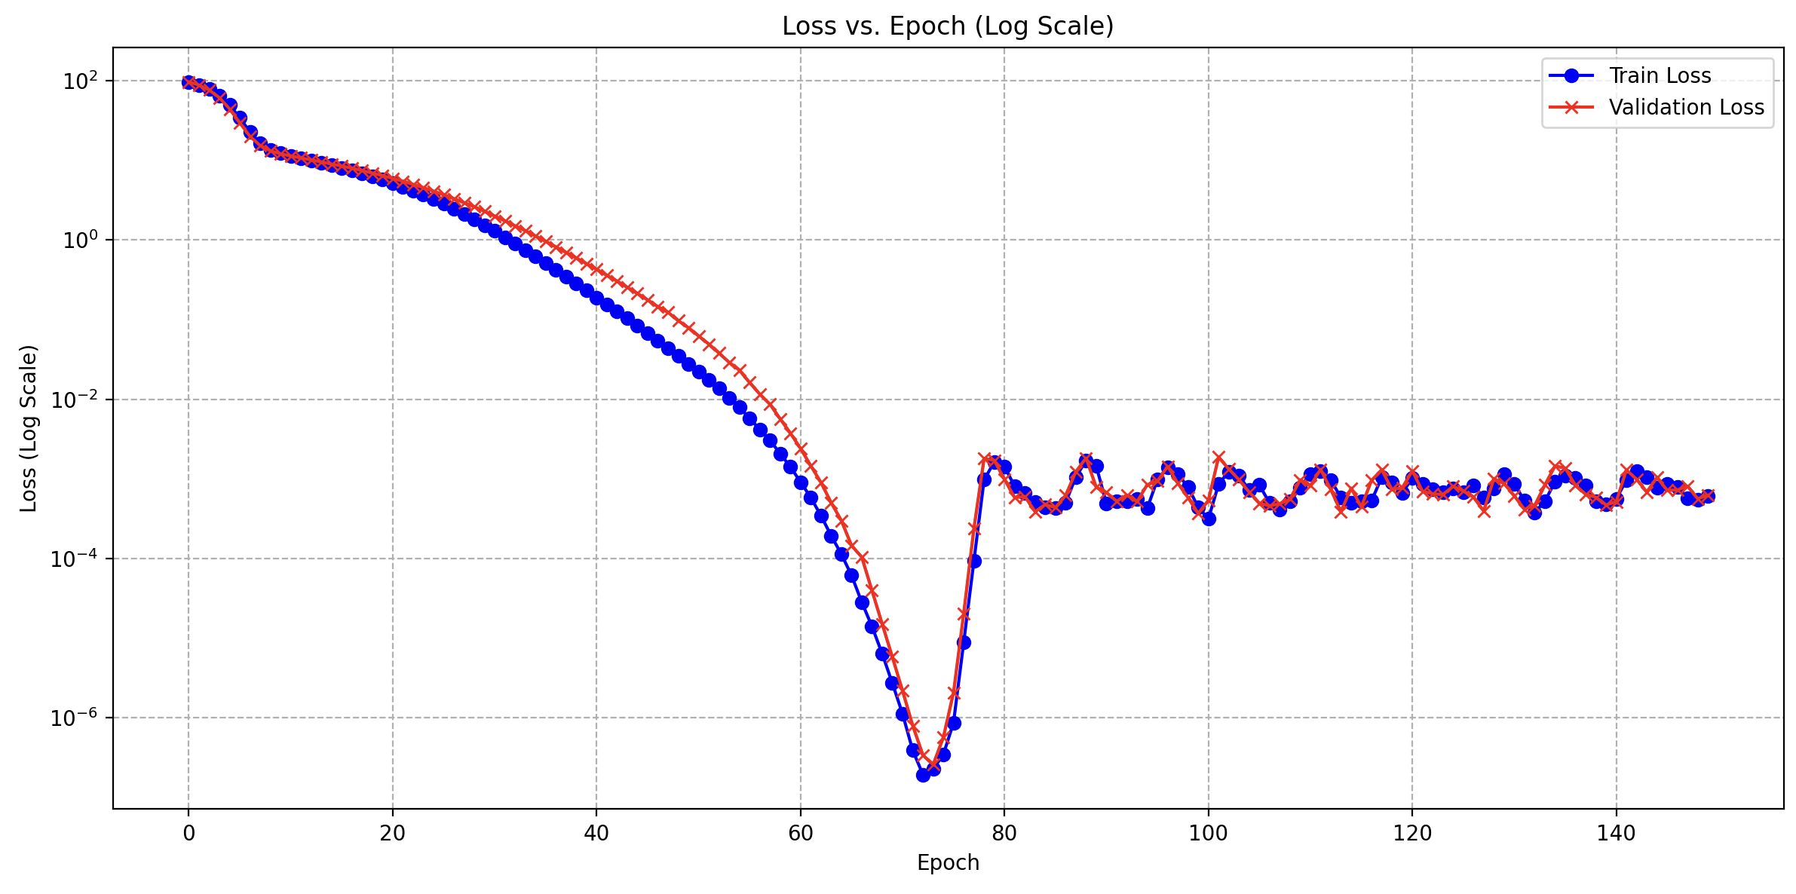
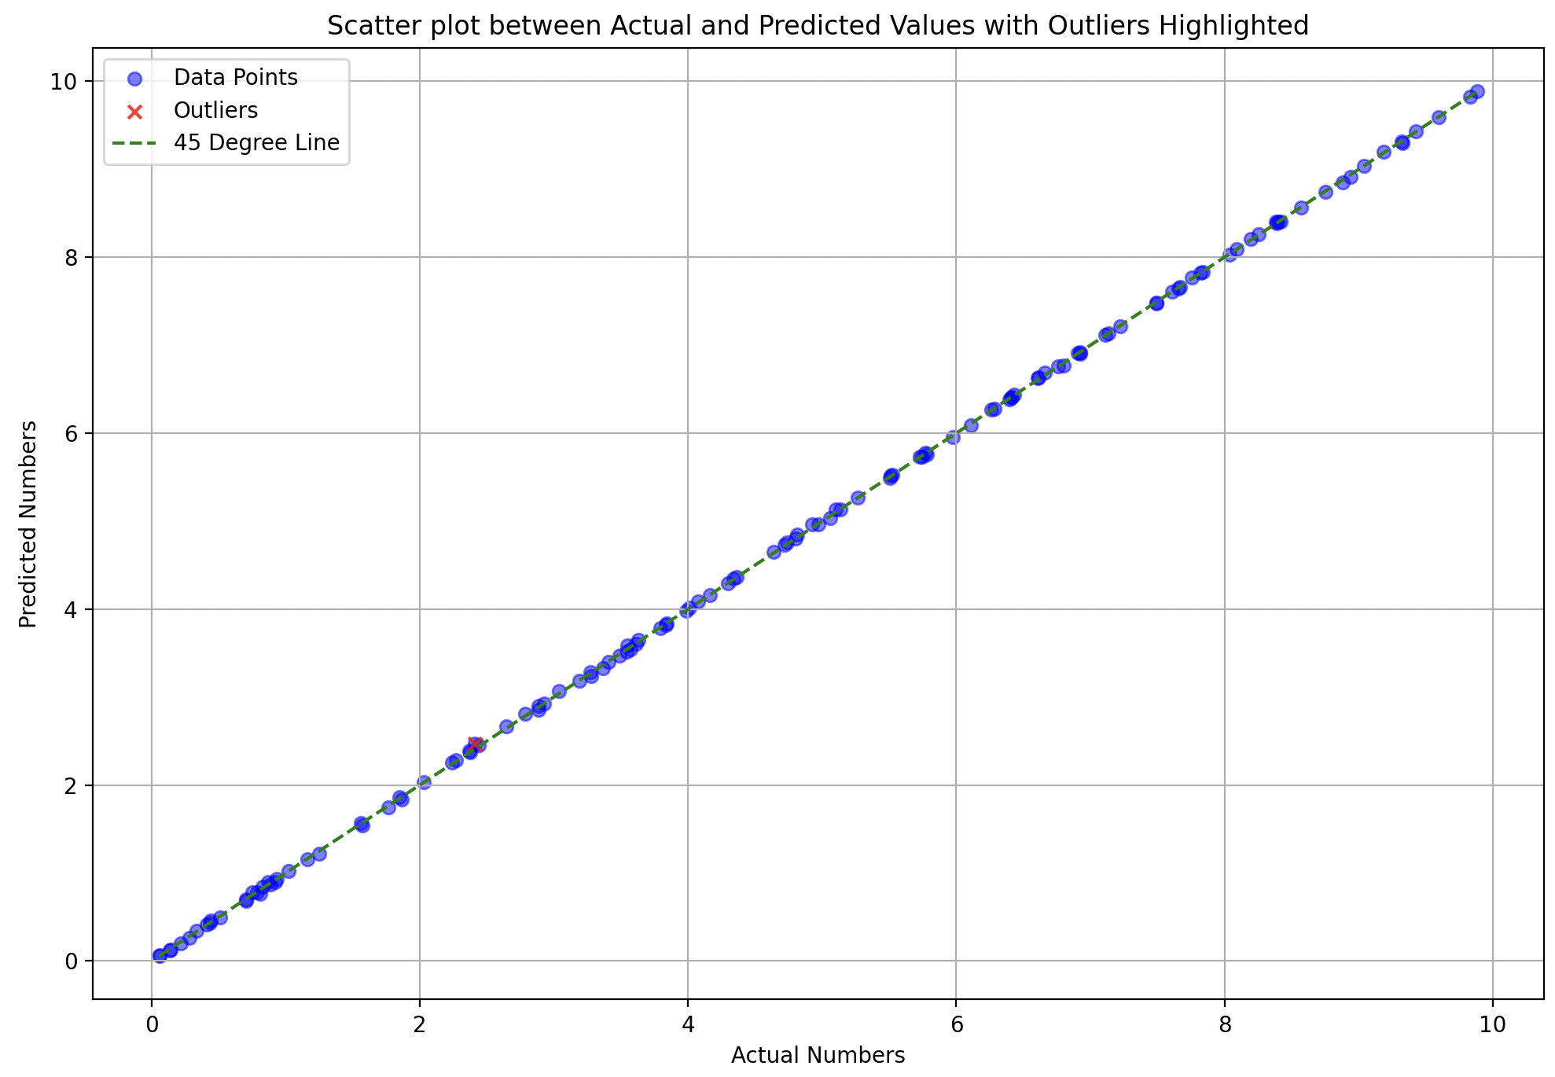
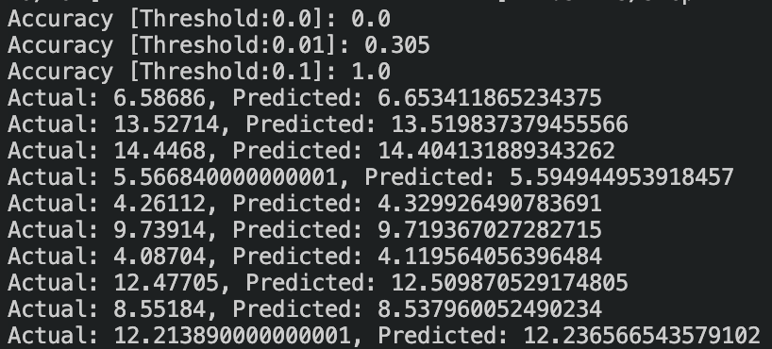
What was wrong?
Train : Test – 40-60

Slide 18
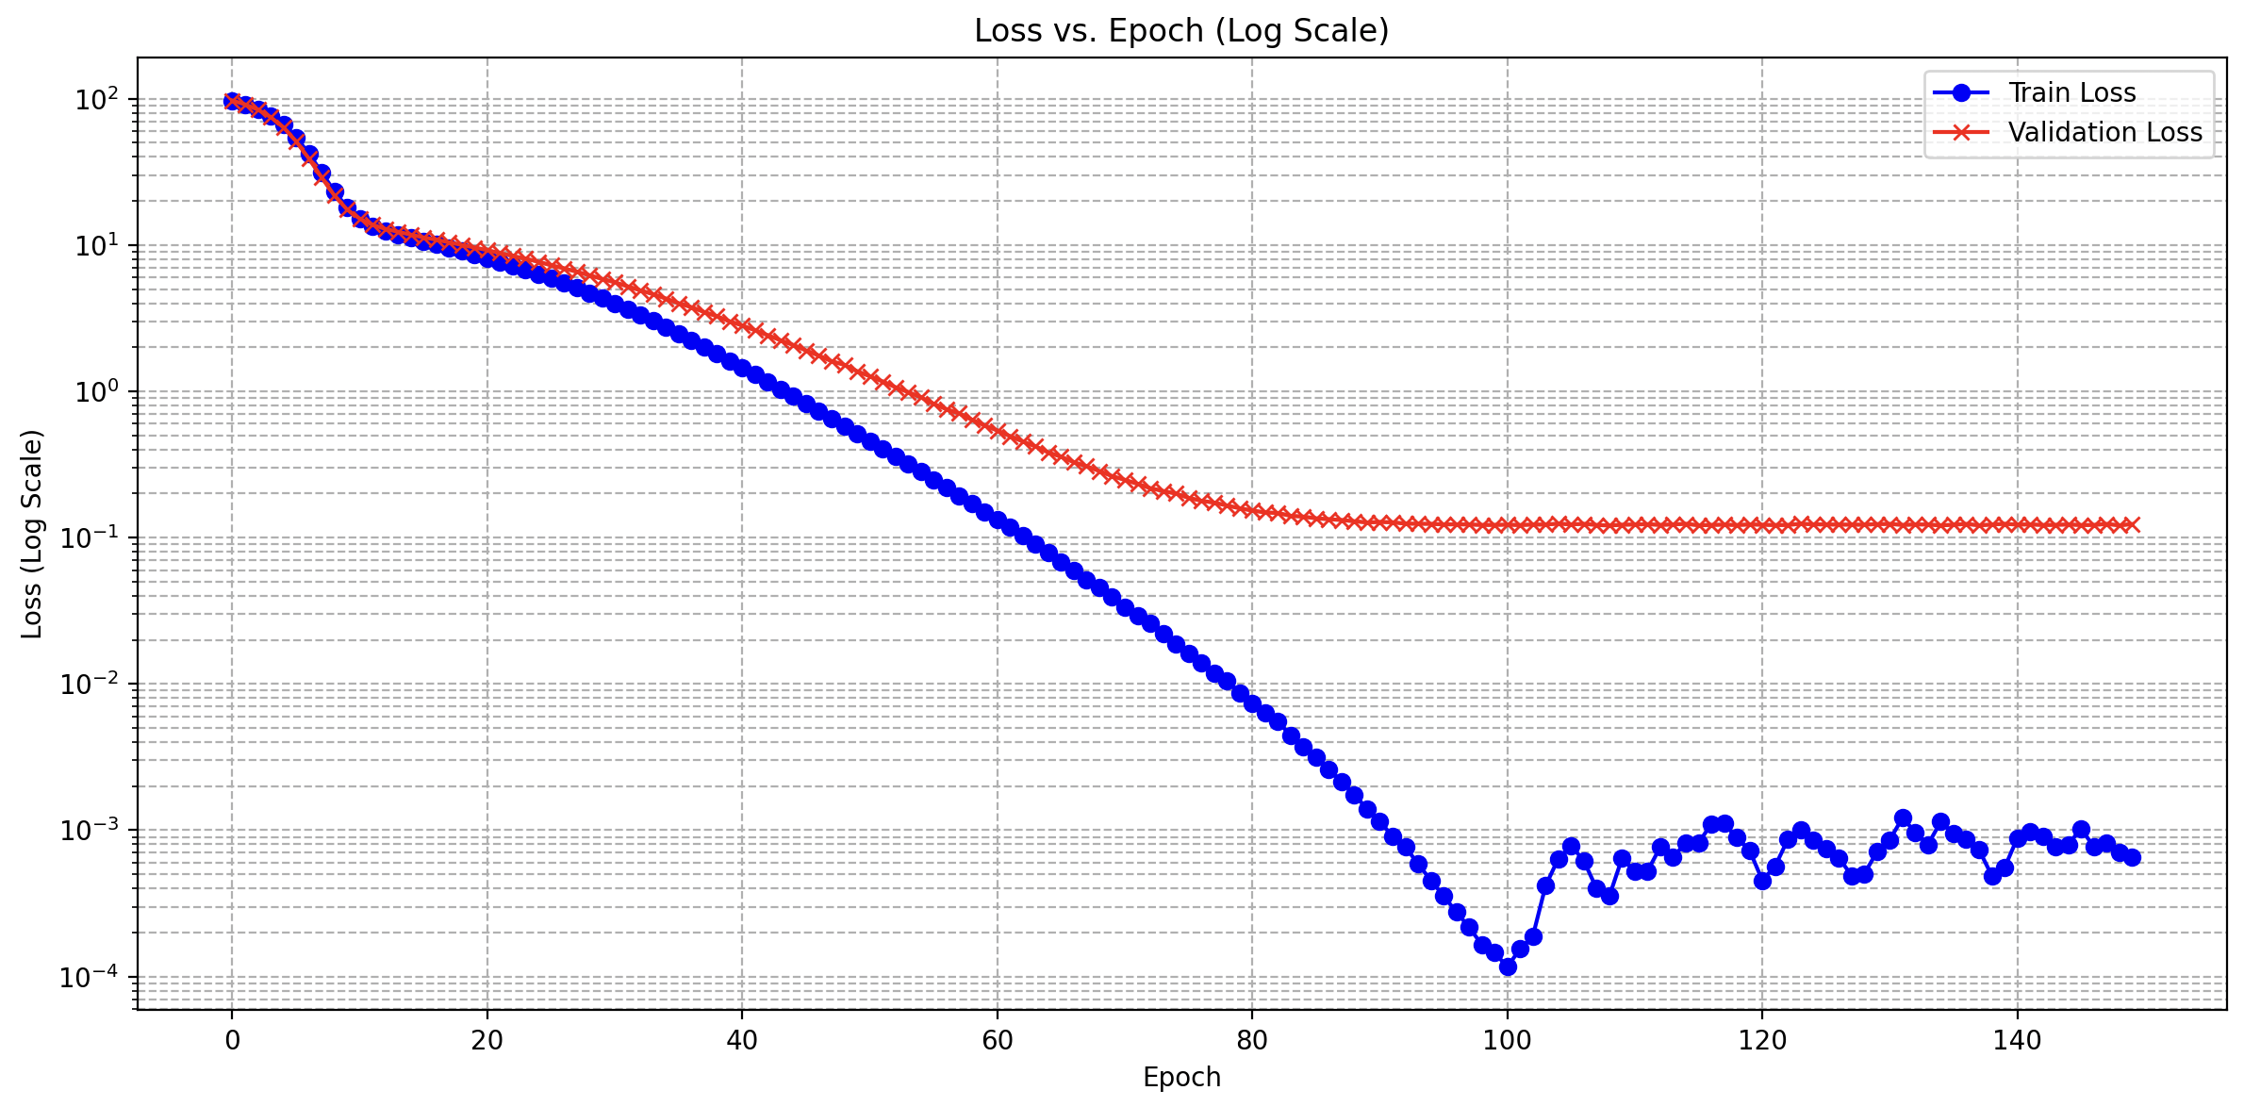
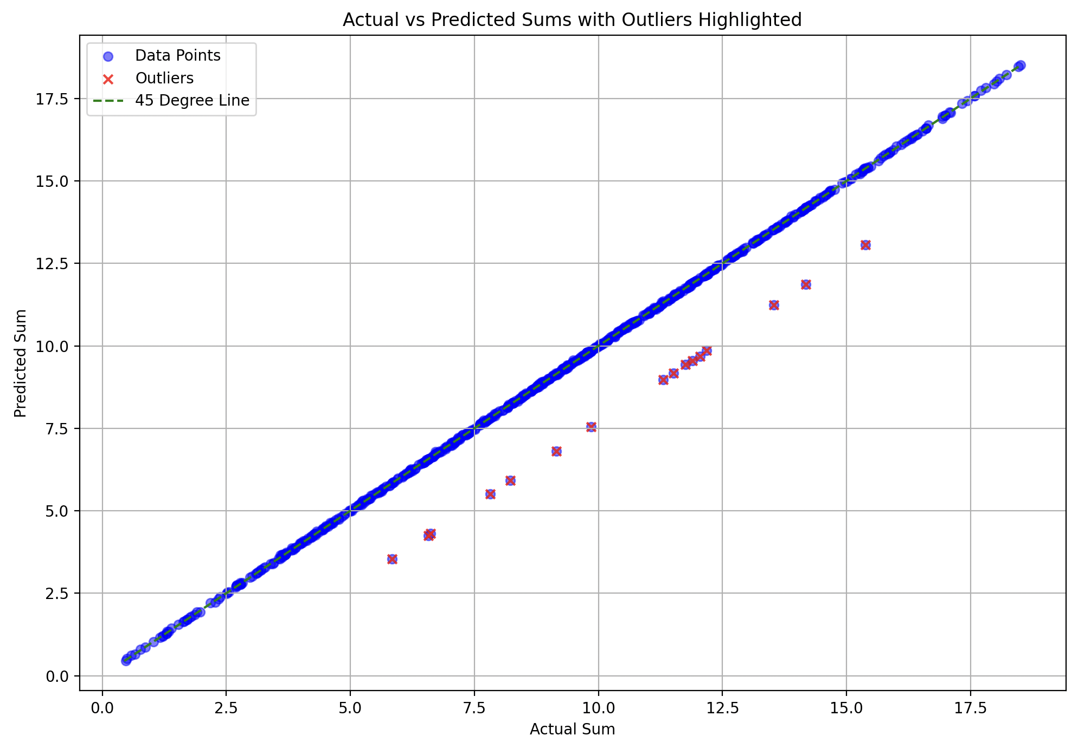


Train : Test – 30-70
not in training

